Slide 1
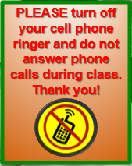
Pre-op Presentation: Joint Replacement Surgery
PLEASE MUTE Your MICROPHONES
and
Turn Off Your Cell Phone Ringer
Do Not Answer Phone Calls During Class.
Thank you!
Presented by: April Asuncion Higgins, BSN, RN, CMSRN
Updated 4-23-2024
Notes:
4-17-2024 updated
The Joint & Spine Center is located on Unit 58, 5th floor of the OB & Critical Care building. The Joint Center is a Center of Excellence collaborating with the patient’s surgeon and clinic, GBMC’s pre-op teams, intra-op teams, post-op nursing and rehab teams, infection prevention team, GBMC Testing Center, and Quality & Safety to help provide evidence-based care and best practices to promote health and healing to those patient’s suffering from osteoarthritis who have elected to undergo a joint replacement. A key component is to educate the patient and their family/support person(s) regarding the importance of pre-op and post-op health optimization, preventing intra-op and post-op problems and complication, decreasing post-surgical site infection, and what to expect throughout the patient’s surgical episode of care to promote a successful surgical encounter, post-surgical recovery and rehabilitation.
GBMC’s Joint Center aligns with the Orthopaedic Specialty of GBMC in the West Pavilion: Drs. Schmidt, Lanzo, Johnston, Melegari. And with the OrthoMaryland group: Drs. Jay, Buchalter, and Heller.

Slide 2
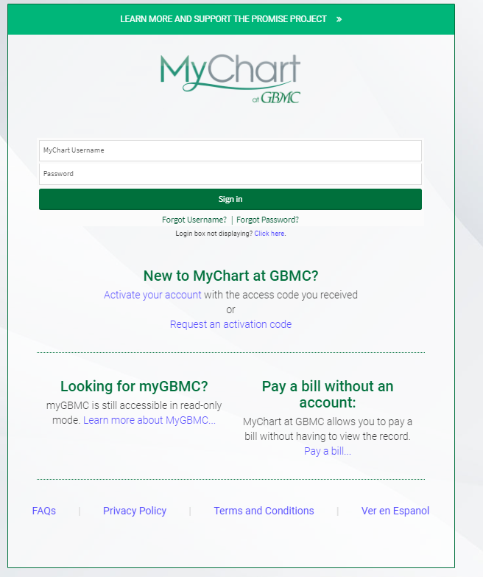
Sign-up for GBMC MyChart
My Chart allows you to verify your health insurance information, mailing address, phone number, e-mail, pharmacy, etc.
MyChart will send reminders for your pre-op appointments and appointments while you are in the hospital.
MyChart gives you access to your test results, allows you to communicate with your providers, pay your bill, and helps you to coordinate your healthcare needs.
On the day of admission: MyChart will convert to MyChart Bedside, it is your portal for engaging with your care while admitted to the hospital. Empower yourself and your family with access to your care team, clinical data, and health education.
Notes:
Updated 2-27-2024.
Patient MUST register/sign-up for MyChart

Slide 3
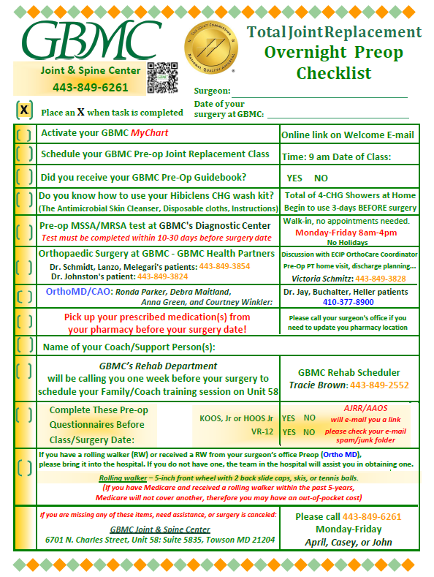
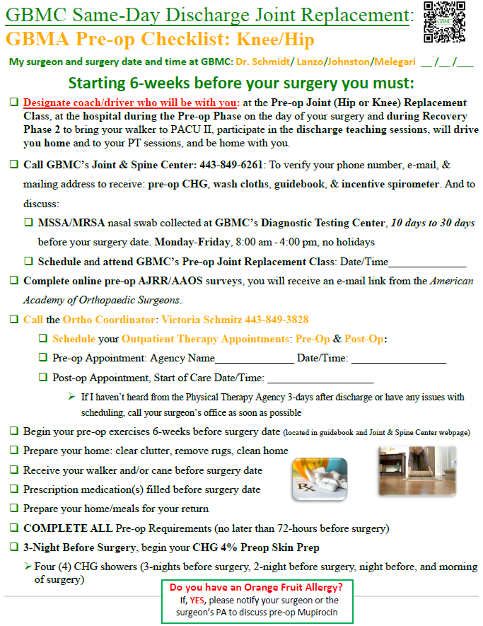
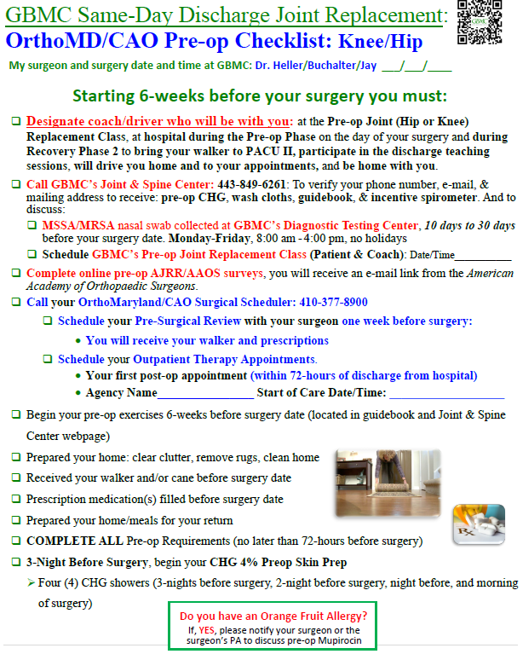
Please review the Joint & Spine Center Pre-op Packet for important information you need to complete:
Pre-op Checklist
(Overnight Stay)
Preop Checkist for Same-Day Discharge
GBMA patients OrthoMD patients
Notes:
Updated 4-17-2024-Preop Checklist Overnight
Of NOTE: Same Day Discharge PATIENTS MUST Schedule their own Outpatient PT before their surgery. Start of Care should be 24-48hr from Discharge Date. There is not a case manager available to set this up.

Slide 4
Time Sensitive Tasks to Complete Before Your Surgery
Nasal swab for MRSA/MSSA
Golden window for completion is within 10-30 days prior to surgery. Must be completed no later than 10 days prior to your surgery date.
Non-Kaiser Permanente patients (GBMA Ortho, GBMA Neurosurgery, Ortho Maryland/CAO)
Testing at GBMC Diagnostic Testing Center
Monday-Friday 8:00 am - 4:00 pm, no holidays
Results valid for 60-days
Preop CHG Wash Kit with directions
Four (4) Showers, begin 3 nights before surgery
Pre-op Questionnaires
Fill your prescriptions before your surgery date
Pre-op Clearance from your Primary Care team(s), Diagnostic Tests, and blood work
Notes:
OrthoMaryland, Dr. Heller will give all equipment and scripts when the patient goes to their pre-surgical review 1 week prior to surgery.
GBMC Diagnostic Testing Center: NEW hours for MSSA/MRSA Swab 8 AM to 4 PM (8/16/2023 approved by Lois Lorenz)
COVID-19 testing is no longer a criteria for elective surgeries at GBMC.
But the patient’s surgeon may order a Covid-19 test to be completed at another testing center.
Kaiser Permanente patients are to have their pre-op MRSA collected at the Kaiser PEEC Center.
UPDATE---Kaiser will no longer be doing joint replacement surgeries at GBMC beginning in September 2022
Non-Kaiser Permanente patients (GBMA Ortho, GBMA Neurosurgery, Ortho Maryland/COA)
Testing at GBMC Diagnostic Testing Center
Monday-Friday 8am-11am only, no holidays
10 days-30 days of surgery date, results valid for 60-days
If the patient is allergic to Orange Fruit Oil and has a positive/abnormal MSSA/MRSA result, a Mupirocin 2% intranasal ointment must begin 5 days before surgery date, BID intranasal application.

Slide 5
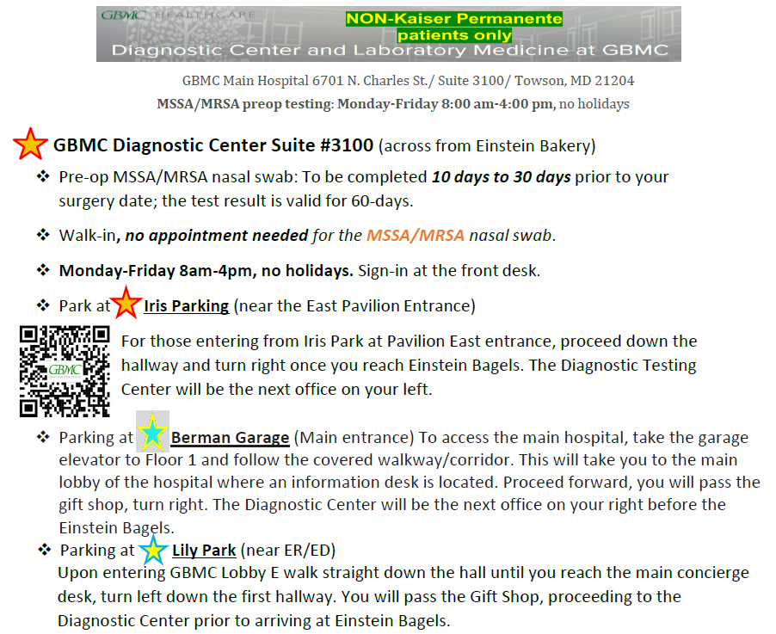
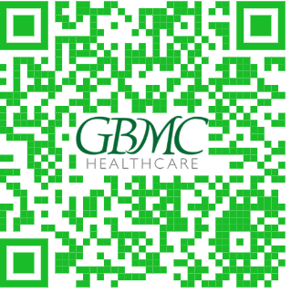
Notes:
Updated 3-18-2024
For NON-Kaiser Permanente patients ONLY
DTC 8/16/2023 UPDATE: Monday-Friday 8:00 AM – 4:00 PM, no holidays

Slide 6
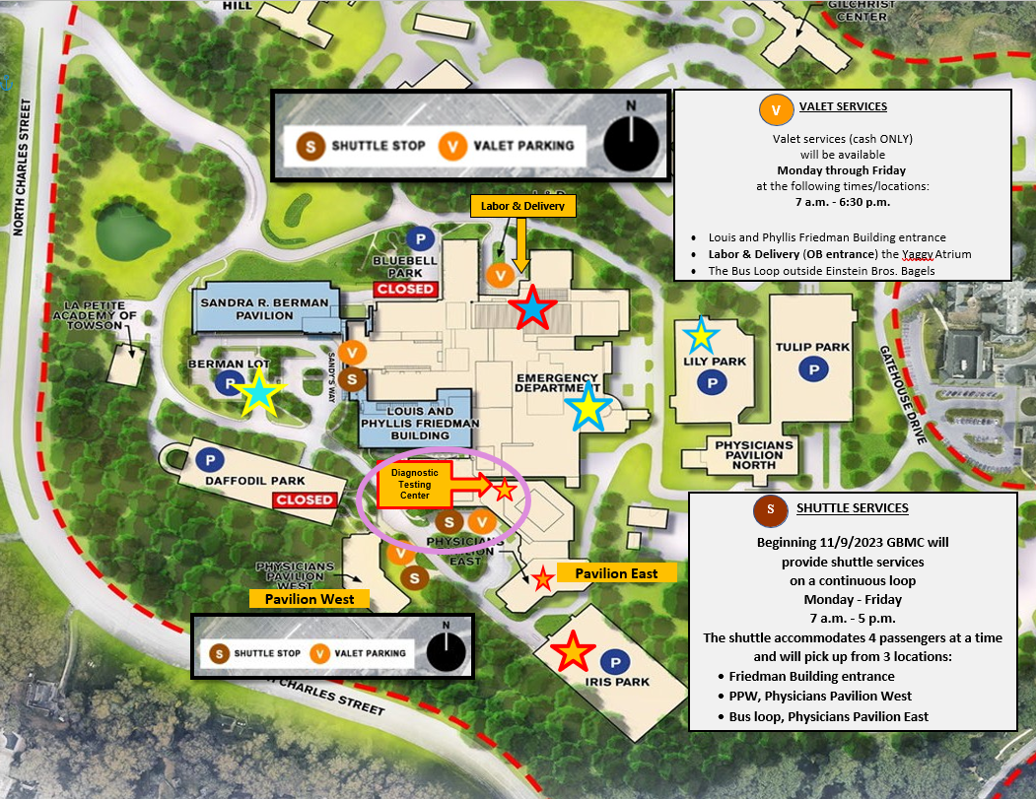
Notes:
Beginning November 9, GBMC will offer a patient and visitor shuttle as well as additional valet services to assist in campus transportation and wayfinding until the Sandra R. Berman Pavilion opens in early 2025. Please familiarize yourself with the valet and shuttle locations and schedule below so you can educate patients and visitors as needed.
VALET SERVICES
Valet services
Will be available Monday through Friday at the following times/locations:
7 a.m. - 6:30 p.m.
Louis and Phyllis Friedman Building entrance
Labor & Delivery (OB entrance, Lobby D) at the Yaggy Atrium
The Bus Loop outside Einstein Bros. Bagels, near Physicians Pavilion West-PPE (Note: Valet service at this location will end once the Berman garage opens for patient and visitor parking later this year.)
8:30 a.m. - 5 p.m.
Physicians Pavilion West (PPW)
SHUTTLE SERVICES
GBMC will provide shuttle services on a continuous loop Monday through Friday from 7 a.m. – 5 p.m. beginning 11/9. The shuttle can accommodate 4 passengers at a time and will pick up from the Friedman Building entrance, PPW, and the bus loop.

Slide 7
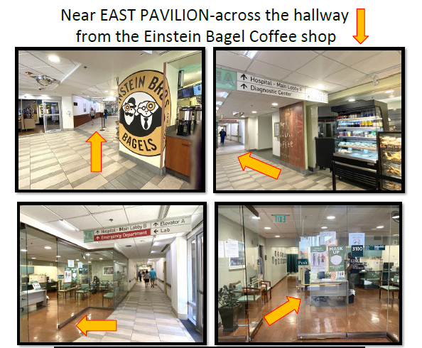
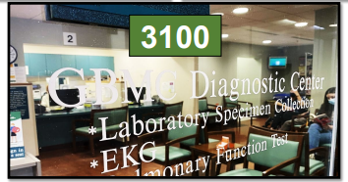
Notes:
DTC 8/16/2023 UPDATE: Monday-Friday 8:00 AM – 4:00 PM, no holidays

Slide 8
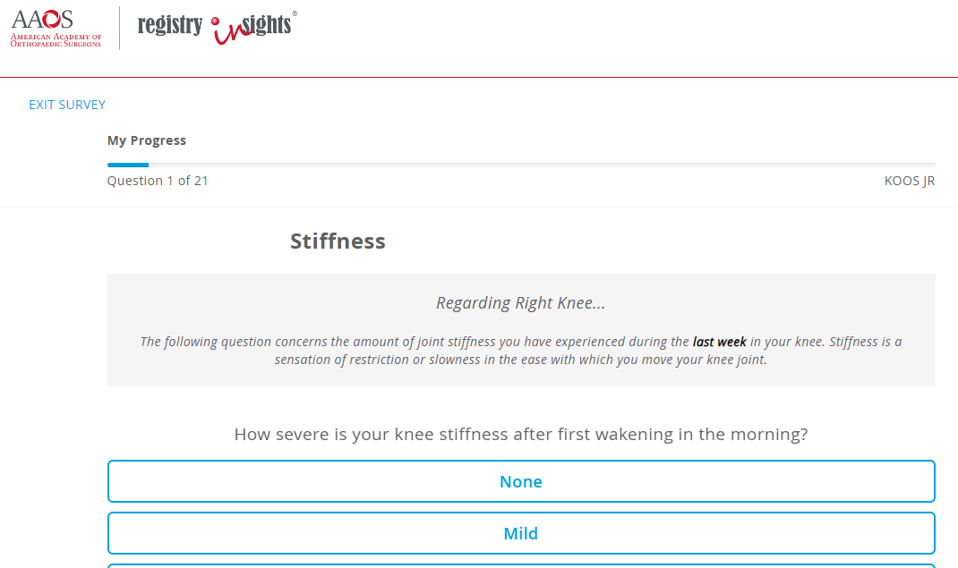
Must be Completed before Your Surgery Date!!
You Will Receive an E-mail Invite from the AAOS/AJRR to Complete These Online Surveys
**Check your spam or junk email**
Two Sets of Questions:
25-27 Questions to Answer
then Choose:
“Save & Complete”
#1
#2
#3
Notes:
Updated 4-23-2024
You will receive an e-mail from the American Academy of Orthopaedic Surgeons (AAOS)/American Joint Replacement Registry (AJRR) with a link to complete the two surveys. YOU MUST COMPLETE online before your surgery date!!! It takes 5 minutes to complete.
HOOS, JR (hip replacement) or KOOS, JR (knee replacement)
VR-12
CJR (Comprehensive Care for Joint Replacement (CJR) Model questions, 3 questions)
ONLY for total hip and total knee patients.
Revisions will need to complete questionnaires
Partial replacements will not receive an e-mail for the AJRR/AAOS
WHY?? The surveys will tell your physician how you were feeling before and how you are feeling after your orthopaedic surgery. Your answers will help you and your physician better understand how you are doing. This information will also help improve care for patients undergoing similar orthopaedic procedures. Your answers to the survey questions are protected and secure. The AJRR system will only share your information with your physician’s office.
All patients are automatically included, an Opt-Out form can be obtained from the J&S Center to be completed and returned.
Look for emails to complete the HOOS, KOOS, & VR-12 (pre-op, 3-month, 1-year
MyChart online or they can be mailed to the Joint Center:
Discharge Questionnaire
I-PSS (male patient only)
Please return the documents to the Joint & Spine Center BEFORE your surgery date!

Slide 9
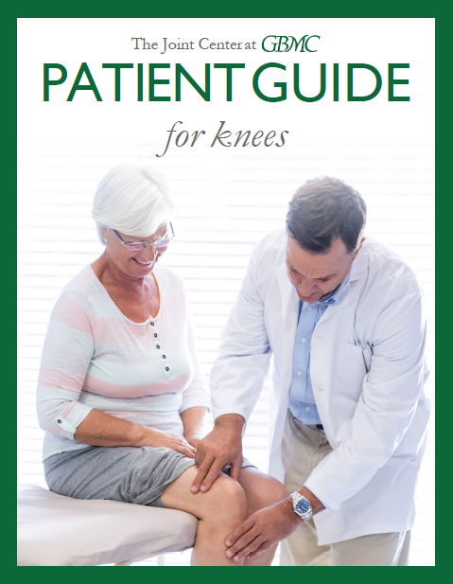
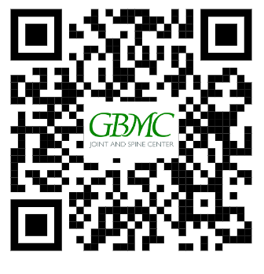
Joint Replacement Guidebooks
Notes:
If you do not have this GBMC Joint Center Guidebook, please call or email the Joint & Spine Center and we can arrange to send it to you.
443-849-6261 or jointspinecenter@gbmc.org

Slide 10
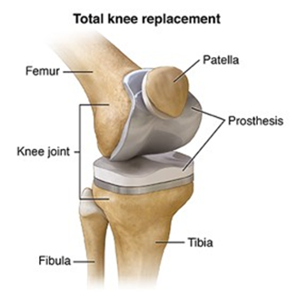
Total Knee Replacement https://orthoinfo.aaos.org/en/treatment/total-knee-replacement
Notes:
Updated 4-26-2024, 2-27-2024
Sources:
Total Knee Replacement/Knee Arthroplasty: https://orthoinfo.aaos.org/en/treatment/total-knee-replacement
Knee Surgery Video 1: https://orthoinfo.aaos.org/en/treatment/total-knee-replacement-animation/
Knee Surgery Video 2: https://orthoinfo.aaos.org/contentassets/4ed13ea26e3f4e4ca5bfda950c3bb904/total-knee-replacement-animation.mp4
Why CPM Machines are not offered at GBMC post-surgery:
American Academy of Orthopaedic Surgeons
View all recommendations from this society
Released May 12, 2020
Avoid routine use of Continuous Passive Motion (CPM) after knee arthroplasty
https://www.choosingwisely.org/clinician-lists/aaos-avoid-routine-use-of-continuous-passive-motion-cpm-after-knee-arthroplasty/
Strong evidence supports that CPM after knee arthroplasty (KA) does not improve outcomes
Guideline: Surgical Management of Osteoarthritis of the Knee
STRONG EVIDENCE does not improve outcomes
https://www.orthoguidelines.org/go/cpg/detail.cfm?id=1319

Slide 11
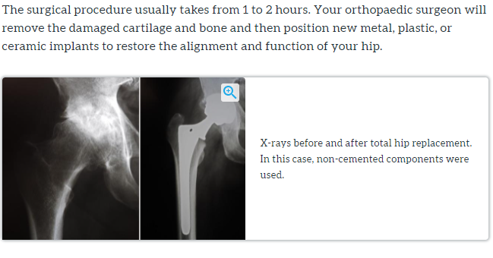
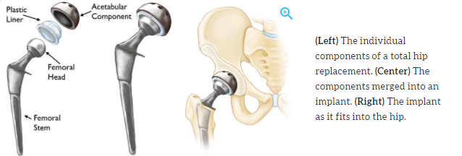
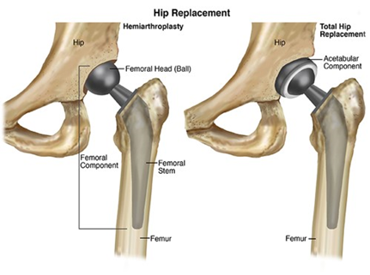
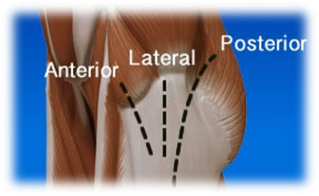
Total Hip Replacement
https://orthoinfo.aaos.org/en/treatment/total-hip-replacement
Notes:
Updated 4-26-2024, 2-27-2024
Sources:
Total Hip Replacement/Hip Arthroplasty: https://orthoinfo.aaos.org/en/treatment/total-hip-replacement
Hip Surgery Video 1: https://orthoinfo.aaos.org/en/treatment/total-hip-replacement-animation/
Hip Surgery Video 2: https://orthoinfo.aaos.org/contentassets/06749e3ab7434cc380f6c5e581e987a2/total-hip-replacement-animation.mp4

Slide 12
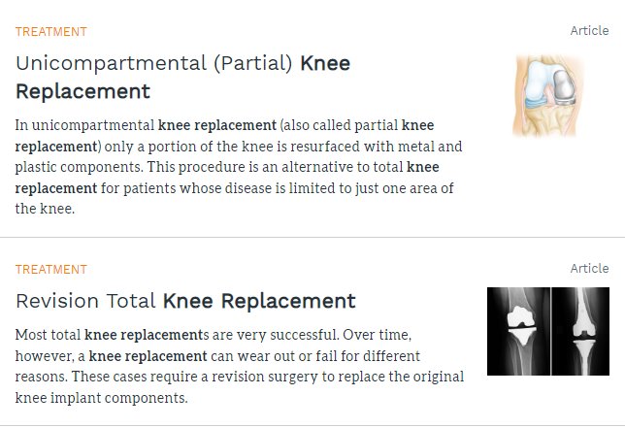
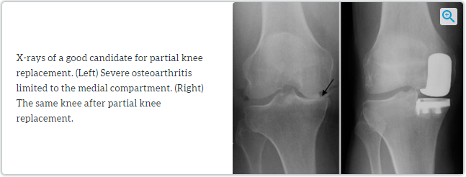
Notes:
4-26-2024
Sources:
Partial Knee Replacement/Unicompartmental Knee Replacement: https://orthoinfo.aaos.org/en/treatment/unicompartmental-knee-replacement
Revision of a Total Knee Replacement: https://orthoinfo.aaos.org/en/treatment/revision-total-knee-replacement/
Revision of a Total Hip Replacement: https://orthoinfo.aaos.org/en/treatment/revision-total-hip-replacement/
Why CPM Machines are not offered at GBMC post-surgery:
American Academy of Orthopaedic Surgeons
View all recommendations from this society
Released May 12, 2020
Avoid routine use of Continuous Passive Motion (CPM) after knee arthroplasty
https://www.choosingwisely.org/clinician-lists/aaos-avoid-routine-use-of-continuous-passive-motion-cpm-after-knee-arthroplasty/
Strong evidence supports that CPM after knee arthroplasty (KA) does not improve outcomes
Guideline: Surgical Management of Osteoarthritis of the Knee
STRONG EVIDENCE does not improve outcomes
https://www.orthoguidelines.org/go/cpg/detail.cfm?id=1319

Slide 13
Preparing for Surgery: Health Condition Checklist
Before and After Total Joint Replacement
Outpatient Total Joint Replacement
Possible Complications of Surgery
Realistic Expectations
Resuming Orthopaedic Surgery After COVID-19
Notes:
Reasons for Joint Replacement Surgery: Improve quality of living, Tired of living in pain, and Not being able to do things you like to do
Updated 4-26-2024, 2-27-2024
Sources:
Preparing for Surgery Health Check List: https://orthoinfo.aaos.org/en/treatment/preparing-for-surgery-health-condition-checklist/
Before and After Total Joint Replacement: https://orthoinfo.aaos.org/en/treatment/before-and-after-total-joint-replacement-video/
Outpatient Joint Replacement: https://orthoinfo.aaos.org/en/treatment/outpatient-joint-replacement-surgery/
Possible Complications of Surgery:
Joint Replacement Infections: https://orthoinfo.aaos.org/en/diseases--conditions/joint-replacement-infection/
Manipulation of Knee: https://orthoinfo.aaos.org/en/treatment/manipulation-under-anesthesia/
Dislocation After A Hip Replacement Video: https://orthoinfo.aaos.org/en/recovery/dislocation-after-total-hip-replacement-video/
Preventing Blood Clots After Orthopaedic Surgery Video: https://orthoinfo.aaos.org/en/recovery/preventing-blood-clots-after-orthopaedic-surgery-video/
Resuming Orthopedic Surgery After Covid: https://orthoinfo.aaos.org/en/treatment/resuming-othopaedic-surgery-after-covid-19/
Why CPM Machines are not offered at GBMC post-surgery:
American Academy of Orthopaedic Surgeons
View all recommendations from this society
Released May 12, 2020
Avoid routine use of Continuous Passive Motion (CPM) after knee arthroplasty
https://www.choosingwisely.org/clinician-lists/aaos-avoid-routine-use-of-continuous-passive-motion-cpm-after-knee-arthroplasty/
Strong evidence supports that CPM after knee arthroplasty (KA) does not improve outcomes
Guideline: Surgical Management of Osteoarthritis of the Knee
STRONG EVIDENCE does not improve outcomes
https://www.orthoguidelines.org/go/cpg/detail.cfm?id=1319

Slide 14
Total Joint Replacement: Enhanced Recovery After Surgery
Goals on Day
of Surgery
Results from
ERAS Protocols
Drinking
Eating
Analgesia
Mobilizing
Sleeping
Decreased complications
Decreased length of stay
Decreased pain after surgery
Decrease use of narcotics
Notes:
ERAS Society
The mission of the Society is to develop peri-operative care and to improve recovery through research, education, audit and implementation of evidence-based practice.
https://erassociety.org/eras-society-hip-and-knee-recommendations/
https://www.tandfonline.com/doi/full/10.1080/17453674.2019.1683790?scroll=top&needAccess=true
Multimodal interventions
Preop education
Patient Optimization
Pain Relief
Exercise
Stress Attenuation
Multi-disciplinary approach
Surgeons
Anesthesiologists
CRNAs
Pharmacists
Advance Practitioners (NP/PA)
Registered Nurses
Physical Therapists (PT)
Occupational Therapists (OT)
Patient/Nurst Support Tech
The Patient
Joint Pain Solution Pre-mixed by pharmacy (Ropivacaine 0.5% 175 mg, Epinephrine 0.5 mg, Ketorolac 30 mg, Clonidine 0.08 mg)—ERAS Policy STAT 2023

Slide 15
Preoperative Testing & Plan of Care for Discharge
Discharge planning begins
Home with outpatient physical therapy
Home with home physical therapy
Designating a family/friends support person(s)
Preparing your home environment
If you have a rolling walker (RW) or received a RW from your surgeon’s office preop (Ortho MD), please bring it into the hospital. If you do not have one, the team in the hospital will assist you in obtaining one.
Rolling Walker with 5-inch front wheels with 2 back slide caps, skis, or tennis balls.
Be sure the height and width of walker is appropriate for you.
Cane or Crutches
If your primary insurance is MEDICARE and you received an ambulatory DME item (rollator, rolling walker, cane) in the last 5 years, please be aware that your health insurance will not cover a new item.
All pre-op testing and diagnostic tests MUST be completed 10-30 days from surgery date:
MSSA/MRSA nasal swab, EKG, echocardiogram, blood work, urinalysis, x-rays, etc
Need Surgical Clearance from
Primary Care Physician
Specialist, if applicable
At least 10-30 days before your surgery date
Results and Surgical Clearance statements from you doctor(s) will need to be available to GBMC no later than 3-days before surgery.
Notes:
Updated 4-17-2024 ---walker
As soon as you have made the decision to undergo an elective joint replacement, discharge planning begins. At this pre-op phase of your Joint Replacement planning, you must:
Designate your support person or persons
Inspect the two-wheel rolling walker or cane you have for function and safety. Please note, If your primary insurance is MEDICARE and you received an ambulatory DME item (rollator, rolling walker, cane) in the last 5 years, please be aware that your health insurance will not cover a new item.
Dr. Heller will “give all equipment and scripts when the patient goes to their pre-surgical review 1 week prior to surgery”. 11/8/2023 D.M.
Start to clean and prepare your home
You will need to be cleared for surgery by your primary care team member.
You must complete all your pre-op testing and diagnostic test 10 to 30 days before your surgery date.
Dental Clearance is not needed.
Failure to have these results and clearance statements from you doctors may delay, postpone, or cancel your surgery.
------------------
Ortho Care Coordinator(s)
To assist with coordinating care and scheduling your Pre-op In-Home Physical Therapy Assessment
GBMC Orthopaedic Health Partners (ONLY Drs. Schmidt, Koehler, Lanzo, Melegari, and Johnston)
Victoria "Tori" Schmitz, LMSW 443-849-3828
OrthoMD (Dr. Buchalter, Dr. Jay, and Dr. Heller), does not participate in this pre-op in-home PT program
Courtney Winkler or Ronda Smallwood, 410-377-8900
Discharge planning begins as soon as you decide to have a joint replacement
Designate before your surgery who are your support/coach person(s)
Prepare your home
Inspect borrowed equipment
Patients are discharging home the next day, POD#1
If you have a rolling walker (RW) or received a RW from your surgeon’s office preop (Ortho MD), please bring it into the hospital.
If you do not have one, the team in the hospital will assist you in obtaining one.
If your primary insurance is MEDICARE and you received an ambulatory DME item (rollator, rolling walker, cane) in the last 5 years, please be aware that your health insurance will not cover a new item.
MRSA/MSSA testing must be within 60 days of surgery date; results valid for 60-days.
Kaiser patients will need to have the test collected at Kaiser
Non-Kaiser GBMC surgeons at GBMC Diagnostics Testing Center: Monday-Friday 8:00 am- 4:00 pm, NO HOLIDAYS (8-16-2023)
Physician clearance must be within 21–30-day window of surgery date, no later than 3-days before surgery.
Failure to have these results and clearance statements from you doctors may delay, postpone, or cancel your surgery.
We would advise getting all dental issues attended to prior to the procedure (outside of the two-weeks prior to surgery). We advise against any dental work within 3 months of surgery postop.

Slide 16
Benefits of Pre-Operative In-Home Physical Therapy Assessment
Pre-Operative Measurements
Establish Baseline Mobility, Strength and Range of Motion
Results Communicated with Inpatient Therapists
Home Safety Tips
Experienced Clinicians optimize your living environment
Recommend equipment and prepare you for discharge home
Assistive Device Training
Prepare for using a walker or cane to navigate your home after surgery
Exercise Review
Discharge Plan Discussion
Ask questions and forecast your post-operative plan
GBMA Ortho:
Dr. Schmidt, Johnston, Melegari, Lanzo
CALL TODAY!
Victoria "Tori" Schmitz,
443-849-3828
Notes:
ONLY for GBMA Orthopaedic Partners: Drs. Schmidt, Johnston, Melegari, Lanzo, Koehler
Victoria “Tori” Schmitz will call you to discuss the and possibly setup the Preop Home PT Visit.
If patients plan to be discharge home with outpatient PT at a facility
Discuss this with Tori Schmitz
You can call ahead before surgery, to set up their first post-op PT appointment within 24-48 from the discharge day.
ActiveLife, Agape, ATI, etc
OrthMD/CAO does not participate in the Pre-op PT Home Visits.
Tori does not call these patients!
This is not a service available to Dr. Buchalter, Dr. Jay, and Dr. Heller patients.

Slide 17
Preparing for Surgery: Health Condition Checklist How to Prevent Infection and Complications
Control your blood sugar before, during and after your surgery.
Exercising and healthy weight loss.
You must STOP smoking (including cigars, e-cigarettes and vaping) 2 weeks before surgery and at least 2 weeks after surgery
Good nutrition with adequate calories and protein.
Making sure skin is dry in between skin folds.
Frequent UTI’s, notify your primary team & surgeon.
Advised no dental work within the 2-weeks prior to surgery and/or the first 3-months after surgery.
No artificial nails, acrylics, gel/dip/shellac polish on fingernails. Only clear, clean nails.
Keep pets and animals away from the incision site after surgery.
Applying fresh linens to bed before surgery. No pets are to sleep in bed or on the sofa with you until cleared by your surgeon.
Resources:
https://orthoinfo.aaos.org/en/treatment/surgery-and-smoking/
https://orthoinfo.aaos.org/en/treatment/preparing-for-surgery-health-condition-checklist/
https://orthoinfo.aaos.org/en/treatment/preventing-infection-after-joint-replacement-surgery-video/
Notes:
Updated 2/27/2024
We advise no dental work within the 2-weeks before surgery. We advise against any dental work within 3 months of surgery postop. A dental clearance is not needed.
Patients at highest risk for complications and infections have one or all:
Preventing Infection After Joint Replacement Surgery
(https://orthoinfo.aaos.org/en/treatment/preventing-infection-after-joint-replacement-surgery-video/)
Diabetes: Uncontrolled diabetes can slow the healing of your surgical wound, and put you at an increased risk for infections, and kidney and heart problems.
https://orthoinfo.aaos.org/en/treatment/preparing-for-surgery-health-condition-checklist/
Smokers: Smoking affects blood circulation, delays healing, slows recovery, increasing post-op blood clots, and may increase the risk of infection.
https://orthoinfo.aaos.org/en/treatment/preparing-for-joint-replacement-surgery/
https://orthoinfo.aaos.org/en/treatment/surgery-and-smoking/
BMI >39: Morbid Obesity: Obesity has been shown to increase a person’s risk of having a medical or surgical complication both during and after surgery, such as wound healing problems and infection.
https://orthoinfo.aaos.org/en/treatment/weight-loss-and-joint-replacement-surgery/
GBMC J&S Center Web page offers resources in the COMMUNITY OUTREACH INFORMATION section: https://www.gbmc.org/jointandspine

Slide 18
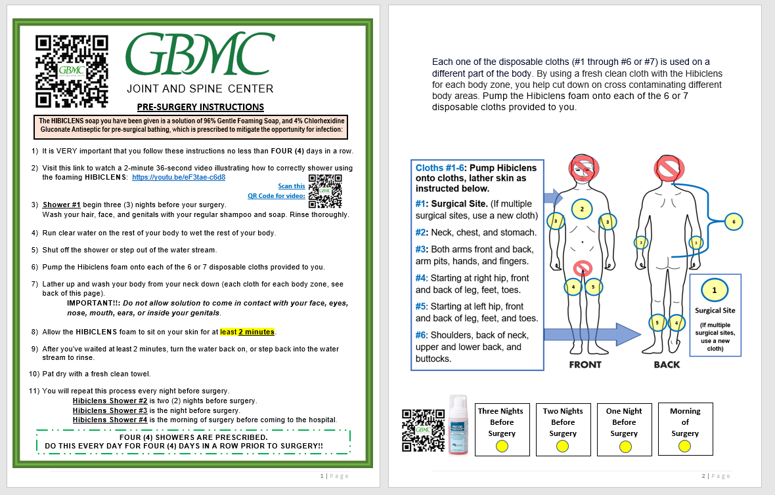
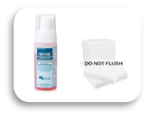
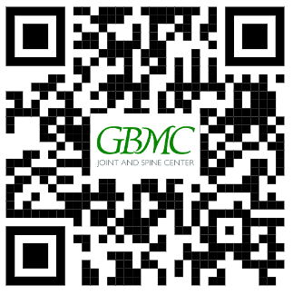
Pre-surgery Hibiclens CHG Showers
Preventing Surgical Site Infection: Pre-Op Skin Preparation
Hibiclens Shower #1 begin three (3) nights before your surgery
Hibiclens Shower #2 is two (2) nights before surgery.
Hibiclens Shower #3 is the night before surgery.
Hibiclens Shower #4 is the morning of surgery before coming to the hospital.
Check off each yellow circle after your Hibiclens CHG shower
Hibiclens CHG Shower Video
Please note GBMC J&S Center requires patients to complete 4 showers at home before surgery
Notes:
You should have received your pre-op Hibiclens chlorhexidine gluconate (CHG) Foam skin prep. The instructions for use is in your Guidebook and on the Joint & Spine Center Webpage.

Slide 19
4 Days of Pre-surgery CHG Showers
Pre-Surgical Scrub: 4% Chlorhexidine gluconate (CHG).
Four (4) Total CHG Showers at home.
Begin three (3) nights before surgery, last application is on the morning of surgery before coming to the hospital.
Apply the CHG foam onto your 6 or 7 disposable cloths, lather the solution onto skin.
Avoid contact with your eyes, ears, mouth, and genitals.
Do NOT shave or use hair removal lotions, deodorant, perfume, lotion, creams, or oils on your body.
https://vimeo.com/882515698/36b386b075?share=copy
Hibiclens CHG Shower Video
Please note GBMC J&S Center requires patients to complete 4 showers at home before surgery
Notes:
You will begin this skin prep 3 days before surgery with the last shower on the morning of surgery. You will complete 4-CHG showers before you come to the hospital.
Do not use the CHG on your head, face, or genitals.
Once you begin the CHG showers DO NOT shave, or use hair removal lotions, deodorant, perfume or cologne, lotion, creams, Vaseline, or oils on your body.

Slide 20
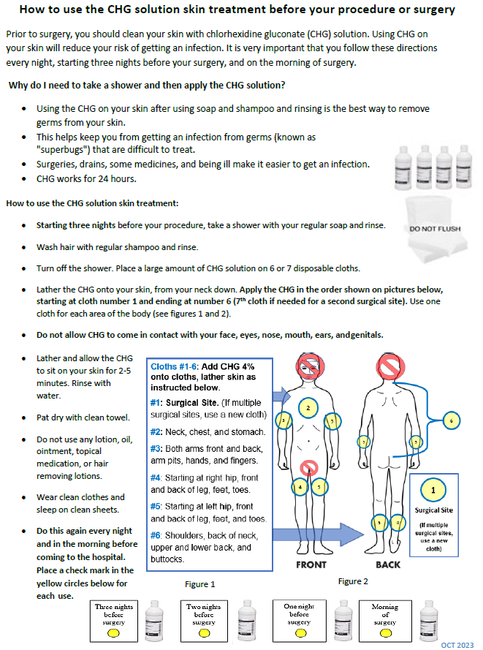
Preventing Surgical Site Infection: Pre-Op Skin Preparation
CHG Shower #1 begin three (3) nights before your surgery
CHG Shower #2 is two (2) nights before surgery.
CHG Shower #3 is the night before surgery.
CHG Shower #4 is the morning of surgery before coming to the hospital.
Check off each yellow circle after your CHG shower
Notes:
You should have received your pre-op chlorhexidine gluconate (CHG) skin prep. The instructions for use is in your Guidebook. Read, check-off the yellow circles after every shower, bring this form with you to the hospital.

Slide 21
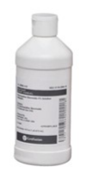
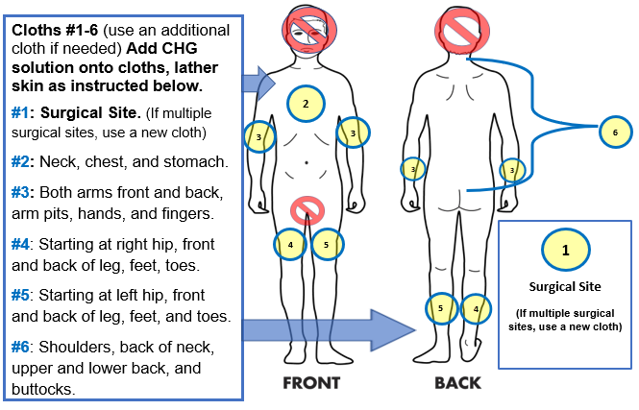
3 Nights Before Your Surgery: Begin Your CHG Showers
Pre-Surgical Scrub: 4% CHG Solution
Use all 4 bottles of CHG, lather the solution onto skin
Start 3 days prior to surgery - every night before bed
Last application is on the morning of surgery
Avoid contact with your eyes, ears, mouth, and genitals
Do NOT shave or use hair removal lotions, deodorant, perfume, lotion, creams, or oils on your body
Notes:
You will begin this skin prep 3 days before surgery with the last shower on the morning of surgery. You will complete 4-CHG showers before you come to the hospital.
Do not use the CHG on your head, face, or genitals.
Once you begin the CHG showers DO NOT shave, or use hair removal lotions, deodorant, perfume or cologne, lotion, creams, Vaseline, or oils on your body.
CHG: The AORN Guideline at a Glance is a key component of the Guideline Essentials (https://www.clinicalkey.com/#!/content/journal/1-s2.0-S0001209216305087)
• refrain from applying alcohol-based hair or skin products, lotions, emollients, or cosmetics.
• refrain from applying deodorant.
• shampoo hair before surgery.
• keep nails clean and free of artificial nail surfaces.
Preop Joint Replacement Gift Bag includes:
4-bottles of CHG wash
1-packet of dry cloths (***DO NOT FLUSH in TOILET**)
Instructions on how to wash and when to start wash:
Incentive Spirometer and directions on how to use it: https://www.youtube.com/watch?v=6G-HftPLvio
Preventing surgical site infections
Do not paint your nails, acrylic or gel nail applications.

Slide 22
Do you have an orange fruit oil allergy?
***You will receive the Nozin at GBMC

Slide 23
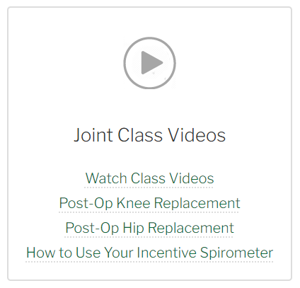
Preparing for Surgery
Exercises for before surgery
Review exercises in your pre-op section of guidebook
Start NOW
2-3 times a day to strengthen your body before surgery
Stop or do less repetitions if pain is severe
Exercises for knee replacement: videos are labeled as post-op exercises but can be used for pre-op readiness:
https://www.gbmc.org/post-op-exercises-for-total-knee-replacement
Exercises for hip replacement: videos are labeled as post-op exercises but can be used for pre-op readiness:
https://www.gbmc.org/post-op-exercises-for-total-hip-replacement
Joint Replacement Class - Video Library - GBMC HealthCare in Baltimore, MD
Notes:
Exercises for knee replacement: videos are labeled as post-op exercises but can be used for pre-op readiness:
https://vimeo.com/showcase/10854641
https://www.gbmc.org/post-op-exercises-for-total-knee-replacement
Exercises for hip replacement: videos are labeled as post-op exercises but can be used for pre-op readiness:
https://www.gbmc.org/post-op-exercises-for-total-hip-replacement

Slide 24
Coach/Support Person
Enlist a family member or friend for help
Exercises
Transfers to the toilet, tub, etc.
Moving around with your walker or cane
Bathing/dressing (using adaptive equipment if needed)
Transportation to appointments
Clean and prepare your home
Food, shopping, preparing meals
Cleaning laundry
Caring for pets, children, grandchildren
Notes:
Designate who your coach/support person will be. Who will stay with you during the first 48-72 hours? Who will drive you to your physical therapy and post-op appointments? Delegate who will be responsible for your pets, children, grandchildren, etc.

Slide 25
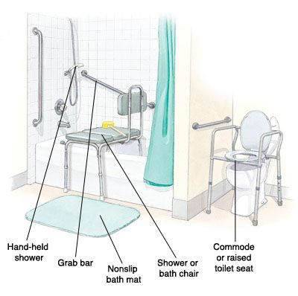
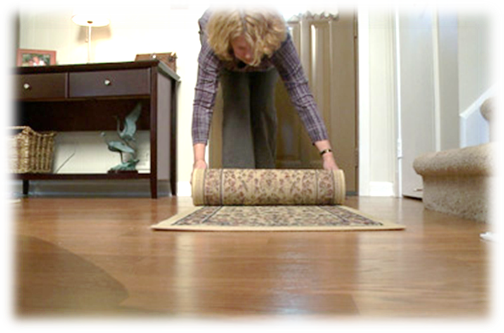
Home Set-up
Before coming to the hospital
Prepare meals ahead of time or arrange to have family/friends there to help
Make frequently used items in the kitchen accessible for use
Clean and clear home of clutter
Remove rugs out of bathroom and kitchen
Make sure all equipment that you may have is/are easily accessible, clean and in safe working order
Rolling Walker is fit to your height and width of hips, and has 5-inch front wheels with 2 back slide caps, skis, or tennis balls
Borrow from friends or family or community loan closets
Notes:
Updated 4-23-2024
DME is typically not covered by health insurance providers. Please consider:
Do you need the equipment?
What is the dimensions of the equipment?
Will this equipment fit in the space you want to place it in?
Be sure to clear a walking path wide enough for the walker to easily pass through from the bedroom, to the living room, to the bathroom, to the kitchen, and exits.
Be sure there is good lighting

Slide 26
Current Medications
Can continue until day of surgery
It is OK to take:
Tylenol (acetaminophen)
Oxycodone, Tramadol, Dilaudid, Neurontin, Flexeril and Skelaxin
Celebrex is the only NSAID that is OK
Beta blocker and/or Calcium Chanel blocker
Non-MAIO Anti-depressants, Anti-anxiety medications, Psychiatric medications
Anti-Seizure medications
Parkinson's medications
Asthma Inhalers/medications
Thyroid medications
Steroids: oral or inhaled
Cholesterol Medication-Statins: Zocor, Lipitor, Pravastatin
Birth Control Pills
Eye Drops
Get specific instructions from you provider for medications listed below:
Eliquis, Coumadin, Pradaxa, Plavix, Xarelto, Ticlid, Lovenox injections, Aspirin, or other blood thinners
Notes:
From Now to the Day of Surgery
TAKE your Tylenol (acetaminophen), Oxycodone (Roxicodone), Hydrocodone, Percocet, Diluadid (hydromorphone), Neurontin (gabapentin), Flexeril, Skelaxin
TAKE your Celebrex, it is the ONLY NSAID you can take until the day of surgery
TAKE your Beta blocker and/or Calcium Chanel blocker:
Beta Blockers: Acebutolol (Sectral),Atenolol (Tenormin), Betaxolol (Kerlone), Bisoprolol (Zebeta), Carvedilol (Coreg), Metoprolol (Lopressor, Toprol XL), Nadolol (Corgard), Nebivolol (Bystolic), Penbutolol (Levatol), Pindolol (Visken), Propranolol (Inderal), Sotalol (Betapace)
Calcium Channel Blockers: Amlodipine (Norvasc®), Clevipidine (Cleviprex®), Diltiazem (Cardizem®), Felodipine (Plendil®), Isradipine (Dynacirc®), Nicardipine (Cardene®), Nifedipine (Procardia®, Adalat®),Nimodipine (Nimotop®), Verapamil (Calan®, Covera-HS®, Verelan®)
TAKE your Heartburn/Ulcer medications/acid blockers (Axid, Pepcid, Prilosec, Reglan and Zantac)
TAKE your Anti-depressants (except MAIO’s: STOP 48 hrs before surgery)
TAKE your Anti-anxiety medications
TAKE your Psychiatric medications (except MAIO’s: STOP 48 hrs before surgery)
TAKE your Anti-Seizure medications
TAKE your Parkinson’s medications
TAKE your Asthma Inhalers/medications
TAKE your Birth Control Pills
TAKE your Eye Drops
TAKE your Thyroid medications
TAKE your Cholesterol medications: Atorvastatin (Lipitor), Fluvastatin (Lescol), Lovastatin (Mevacor), Pitavastatin (Livalo), Pravastatin (Pravachol), Rosuvastatin (Crestor), Simvastatin (Zocor)
TAKE your Blood Pressure medications……..except for Angiotensin Converting Enzyme (ACE) inhibitors and Angiotensin Receptor Blockers (ARB)s (See Pgs. 8 & 9 included in this packet)
Consult your Primary Care Physician or Cardiologist if you are currently taking:
Blood thinners (Coumadin, Lovenox, Xarelto, Plavix, Warfarin, Pradaxa, or Eliquis)
Erectile Dysfunction Drugs (Viagra, Cialis, or Levitra).
Hormone Replacement Therapy

Slide 27
Current Medications
10 Days before surgery
Stop taking aspirin or salicylates, including Excedrin, Alka-Seltzer, Pepto-Bismol, unless otherwise directed by your provider
It is important to stop as they cause excessive bleeding during your surgery and recovery period.
Stop all Herbal Products/Alternative Medications:
Examples: Vitamin E, glucosamine, fish oils, ginkgo biloba, ginseng, dong quai, garlic, turmeric, CoQ10, kava, ma huang, St. John’s wort and non-vitamin supplements
Notes:
10 Days Before Surgery
STOP Aspirin or salicylates including Excedrin, Alka-Seltzer, and Pepto-Bismol.
STOP Herbal medications and non-vitamin supplements
Fish oil/Omega Vitamin E, Glucosamine, Gingko Biloba, Garlic, Ginseng, Tumeric, CoQ10, St. John’s wort, Dong quai, garlic medicinal, kava, ma-huang
Be sure to check your arthritis medication, it may contain one or more of these items.

Slide 28
Current Medications
7 Days before surgery
Stop NSAIDs products
Non-Steroidal Anti-inflammatory Drugs
Examples: Aleve, Ibuprofen (Motrin, Advil), Naproxen, Treximet, Vimovo, Duexis, Nabumetone, Ketolorac, Mobic, Robaxin, Meloxicam, Diclofenac
Stop all diet and weight loss medications
Examples: Phentermine, Glucomannan, CLA (conjugated linoleic acid), Orlistat (Alli), Garcinia cambogia, Hydroxycut, Raspberry ketones, Meratrim, green coffee bean extract, green tea extract, Forskolin, Synephrine, etc
Notes:
1 Week Before Surgery
STOP Non-Steroidal Anti-inflammatory Drugs (NSAIDS):
Ibuprofen
Advil
Motrin
Aleve
Naposyn
Naproxen
Excedrin
Meloxicam
Mobic
Etodolac
Duexis (ibuprofen/famotidine)
Vimovo (naproxen/esomeprazole)
Treximet (sumatriptan/ naproxen)
STOP All diet/ weight loss medications
Phentermine, Glucomannan, CLA (conjugated linoleic acid), Orlistat (Alli), Garcinia cambogia, Hydroxycut, Raspberry ketones, Meratrim, green tea extract, green coffee bean extract, Forskolin, Synephrine

Slide 29
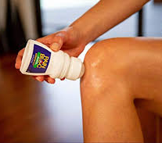
Current Medications
3-days (72 hours) before surgery
Stop Viagra, Levitra & Cialis
Stop topical medications
48 Hours before surgery
Stop Monamine Oxidase Inhibitors (MAIOs)
Examples: Nardil (Phenelzine), Emsam (Selegline), Marplan (Isocarboxazid), Parnate (Tranylcypromine)
Notes:
DO Not stop narcotic pain patches (10/26/2023 approved by Dr. Stein and Dr. Zeichner)
3 Days Before Surgery
STOP Erectile Dysfunction Drugs
Viagra, Cialis, or Levitra Viagra, Levitra & Cialis
STOP topical medications (creams and ointments)
START your Pre-op Showers with the CHG solution/ Hibiclens. (Theraworx if CHG allergic). Continue every night and the morning of surgery. A total of 4 CHG Showers to be completed before surgery.
STOP using lotions, oils, creams, hair removing lotions, etc
Do NOT Shave
2 Days Before Surgery
STOP your Monamine Oxidase Inhibitors (MAIOs)
Nardil (Phenelzine), Emsam (Selegline), Marplan (Isocarboxazid), Parnate (Tranylcypromine)

Slide 30
Current Medications
Do not take the day of your surgery
Stop ACE Inhibitors:
Examples: Lisinopril, Vasotec
Stop Angiotensin Receptor Blockers:
Examples: Cozaar, losartan, Benicar, Candesartan, Atacand, Valsartan
Notes:
Ace Inhibitors
Aceon (perindopril)
Accupril (quinapril)
Accuretic (quinapril/HCTZ)
Altace (Ramipril)
Benazepril
Capoten (captopril/HCTZ)
Captozide (captopril/HCTZ)
Captopril
Enalapril
Fosinopril
Lexxel (enelipril/felodipine)
Lisinopril
Lotensin (benazepril)
Lotrel (amlodipine/benazepril)
Mavik (trandolapril)
Moexipril
Monopril (fosinopril)
Monopril HCT (fosinopril/HCTZ)
Perindopril
Prinivil (lisinopril)
Quinapril
Ramipril
Tarka (trandolapril/HCTZ)
Trandolipril
Uniretic (moexipril/HCTZ)
Univasc (moexipril)
Vaseretic (enalapril/HCTZ)
Vasotec (enalapril)
Zestoretic
(lisinopril/HCTZ)
Zestril
(lisinopril
Angiotensin Receptor Blockers
Atacand (candesartan)
Atacand HCT (candesartan/HCTZ)
Avalide (Irbesartan/HCTZ)
Avapro (Irbesartan)
Azor (olmesartan/amlodipine)
Benicar (olmesartan)
Candesartan
Cozaar (Losartan)
Diovan (valsartan/HCTZ)
Doivan HCT (valsartan/amlodipine)
Eprosartan
Exforge (valsartan/amlodipine)
Exforge HCT (valsartan/HCTZ/amlodipine)
Hyzaar (losartan/HCTZ)
Ibesartan
Losartan
Micardis (telmisartan)
Micardis HCT (telmisartan/HCTZ)
Olmesartan
Telmisartan
Teveten (eprosartan)
Teveten HCT (esprosartan/HCTZ)
Valsart
DO NOT STOP taking your Beta blocker and/or Calcium Chanel blocker heart medication and talk to your primary care or cardiologist to discuss which medications you should take the with a sip of water the morning of your surgery.
Take your Beta Blockers: Acebutolol (Sectral),Atenolol (Tenormin), Betaxolol (Kerlone), Bisoprolol (Zebeta), Carvedilol (Coreg), Metoprolol (Lopressor, Toprol XL), Nadolol (Corgard), Nebivolol (Bystolic), Penbutolol (Levatol), Pindolol (Visken), Propranolol (Inderal), Sotalol (Betapace)
Take your Calcium Channel Blockers: Amlodipine (Norvasc®), Clevipidine (Cleviprex®), Diltiazem (Cardizem®), Felodipine (Plendil®), Isradipine (Dynacirc®), Nicardipine (Cardene®), Nifedipine (Procardia®, Adalat®),Nimodipine (Nimotop®), Verapamil (Calan®, Covera-HS®, Verelan®)
Diuretic medication: Consult with your cardiologist or primary care team about your diuretic medication

Slide 31
Current Diabetic Medications
4 days before surgery
Stop SGLT-2 Inhibitor medications: Steglatro
3 days before surgery
Stop SGLT-2 Inhibitor medications: Jardiance, Invokana, Farxiga, etc
24 Hours before surgery
Stop oral hypoglycemic containing Metformin
Examples: Glucophage, Riomet, Glumetza, Glucophage XR, Fortamet, Avandamet, Actoplus, Glucovance, Actoplus, Glyburide, Glipizide, Invokamet, Jentadueto, Janumet, Kombiglyze XR, Metaglip, PrandiMet, Xigduo, Kazano, Synjardy, Segluromet
All other oral hypoglycemic agents should be held the morning of surgery
Wearable continuous blood glucose monitoring systems: please notify your surgeon and/ or anesthesiologist as soon as possible. GBMC nursing staff will monitor your blood glucose per hospital policy.
If you have a wearable insulin pump system, please notify your surgeon and/or anesthesiologist as soon as possible.
If you are Diabetic notify your endocrinologist of your upcoming surgery
Insulin: your Endocrinologist will advise you on how many units they want you to take and when to take give your last dose before surgery.
Notes:
Updated 12-27-2023
STOP Metformin 24 hours prior to surgery:
ActoPlus Met
Avandament
Fortamet
Glucophage
Glucovance
Glumetza
Glyburide
Glipizide
Invokamet
Jentadueto
Janumet
Kombiglyze XR
Metaglip
Metformin
Prandimet
Riomet
Xigduo
Kazano
Synjardy
Segluomet
Consult your Primary Care Physician and/or Endocrinologist if taking insulin or using an insulin pump

Slide 32
Diabetes Medications…continued
GLP-1 Agonist:
semaglutide (Ozempic, Rybelsus), dulaglutide (Trulicity), exenatide (Bydureon BCise, Byetta), liraglutide (Victoza, Saxenda), lixisenatide (Adlyxin), etc.
**off label use for weight loss
If taken daily: Hold GLP-1 agonists on the day of the procedure/surgery.
If taken weekly: Hold GLP-1 agonists a week prior to the procedure/surgery.
CLEAR LIQUID ONLY DIET starting 12 hours before the usual NPO time (noon the day before surgery if NPO).
Clear Liquids for 24h before surgery
Coffee and tea without milk or non-dairy creamer (sweetener is ok)
Clear, nonfat broths
Fruit & vegetable juices that are strained & pulp free
Sodas & Sports drinks
Pulp-free popsicles
Jell-O
Nothing to eat/drink after 12-midnight
Notes:
Updated 12-27-2023

Slide 33
The Night Before Surgery
NO heavy meals past 8 pm
You can snack up until midnight
NO eating past midnight
Including any mints, hard candies, and gum
Patients who have the following must STOP liquids 6 hours before surgery:
Diabetes
Gastroesophageal Reflux Disease (GERD)
BMI >39 (morbidly obese)
Gastroparesis (slow moving gut)
If you do not have diabetes, GERD, obesity, or gastroparesis:
You CAN drink clear liquids (a max total of 16 ounces) up to 2 hours before your surgery

Slide 34
Current Medications: Morning of Surgery
Blood pressure/cardiac medication
Take your Beta blocker and/or Calcium Chanel blocker heart medication and talk to your primary care or cardiologist to discuss which medications you should take the with a sip of water the morning of your surgery.
Discuss with your primary care or cardiologist if they want you to take your diuretics the morning of your surgery
Examples: HCTZ, Lasix
Heartburn or ulcer medicine
Acid blockers should be taken on the morning of the surgery to reduce the risk of aspiration pneumonia.
Examples: Zantac, Pepcid, Axid, Prilosec, Pantoprazole, Reglan
Antacids should NOT be taken they contain particulate material that may damage the lungs if aspirated
Examples: Maalox, Tums, Carafate
No CBD/THC products on the day of your surgery.
Notes:
Day of Surgery
Take your Beta Blockers: Acebutolol (Sectral),Atenolol (Tenormin), Betaxolol (Kerlone), Bisoprolol (Zebeta), Carvedilol (Coreg), Metoprolol (Lopressor, Toprol XL), Nadolol (Corgard), Nebivolol (Bystolic), Penbutolol (Levatol), Pindolol (Visken), Propranolol (Inderal), Sotalol (Betapace)
Take your Calcium Channel Blockers: Amlodipine (Norvasc®), Clevipidine (Cleviprex®), Diltiazem (Cardizem®), Felodipine (Plendil®), Isradipine (Dynacirc®), Nicardipine (Cardene®), Nifedipine (Procardia®, Adalat®),Nimodipine (Nimotop®), Verapamil (Calan®, Covera-HS®, Verelan®)
Diuretic medication: Consult with your cardiologist or primary care team about your diuretic medication
STOP Theophylline
STOP Antacids (Carafate, Maalox, or Tums)
STOP Stop CBD Oil (cannabidiol)/THC products (7/25/2022-Dr. Trivedi)
Take Medications, if any, as prescribed or recommended by the surgeon or healthcare provider
NO SOLID food, NO MILK products, NO Gum or Mints…..EXCEPT your Pre-op Carb Drink (follow instructions on when and how much to drink)
Complete your 4th CHG/Hibiclens shower, place clean sheets on the bed

Slide 35
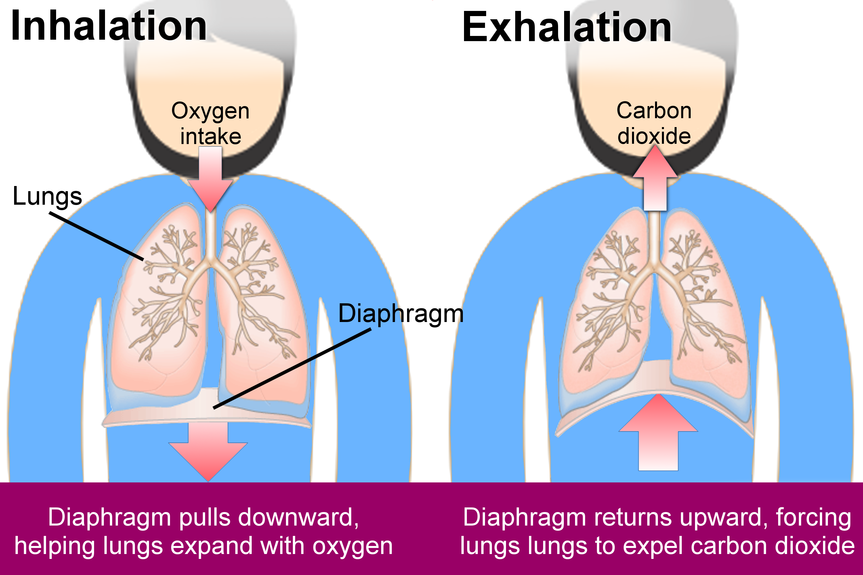
Lung Exercises: Before Surgery & After Surgery
Purpose:
Exercise your lungs to help with oxygen and carbon dioxide exchange before, during, and after surgery. Will help prevent complications such as pneumonia and/or collapse of lungs.
Before surgery: At least 30 times throughout the day, starting in the morning.
After surgery: 10 times an hour when awake.
Incentive Spirometer
Exhale.
Place mouth on mouthpiece.
Take a slow, deep breath in and hold for 5-10 seconds.
Exhale.
Deep Breathing & Coughing
Sit upright.
Take a few slow breaths, then take a slow, deep breath in through your nose.
Hold your breath for 2-5 seconds.
Gently and Slowly breathe out through your mouth making an “O” shape.
Repeat 10-15 times.
Notes:
Video (same technique for pre-op and post-op): https://www.youtube.com/watch?v=6G-HftPLvio

Slide 36
Same-Day Discharge Pre-op Check List
Before Your Surgery: (please refer to your GBMC Same-Day Discharge Joint Replacement Checklists)
Designate your coach/family member who will be coming with you to the hospital, be with you during the pre-op education phase, discharge phase for the nurse education and training with the physical therapy, and to drive you home from the hospital. This person will need to present at the hospital on the day of your surgery.
Complete your pre-op surgical scrub as instructed
Four (4) CHG showers
MSSA/MRSA nasal swab collected at GBMC’s Diagnostic Center, results available
Prescriptions filled
All Pre-op Requirements Met
GBMA Ortho group
Schedule your Post-op Rehab Appointments (SELF-Schedule)
ActiveLife: (410) 842-0115
Start of Care Date (24 to 48 after you leave hospital) : / / ____
Bring to the hospital:
State issued driver’s license
Insurance Card
Advance Directive
Walker and/or Crutches
OrthoMD/CAO group
Schedule your Post-op Rehab Appointments (SELF-Scheduled task)
Surgical Scheduler: (410) 377-8900
Outpatient PT Start of Care Date:
(24 to 48 after you leave hospital): / / .
Notes:
Updated 3-28-2024: Same Day Discharge PATIENTS MUST Schedule their own Outpatient PT before their surgery. Start of Care should be 24-48hr from Discharge Date. There is not a case manager available to set this up.
GBMC approved same-day discharge service for Dr. Schmidt, Lanzo, and Heller.
Dr. Heller’s patients ONLY: he will give all equipment and scripts when they come for their pre-surgical review 1 wk prior to surgery.

Slide 37
What to Bring to the Hospital
Your ID card
Insurance card(s)
Advance directive (if you have one, bring a copy)
Joint Replacement Guidebook
If you already have: Walker w/ 2-front wheels, cane, or crutches from home (place your full name on the device)
Bring your eyeglasses, contact lenses, and hearing aids
Regular clothing
Loose fitting shorts or pants; elastic waist is easiest, under garments
Walking shoes with good ankle support (no open heel shoes). Do not buy new shoes: bring something comfortable
Any braces, shoe inserts or splints that you normally use
CPAP machine** (Patients with sleep apnea, overnight stay only)
Notes:
CPAP RECALL June 2020: FYI, the correct website address for recall: https://www.usa.philips.com/healthcare/e/sleep/communications/src-update
Bring rolling walker from home if you have one - to ensure proper fit and condition. You do not have to purchase your own before surgery.
Dr. Heller will give all equipment and scripts when the patient goes to their pre-surgical review 1 week prior to surgery.

Slide 38
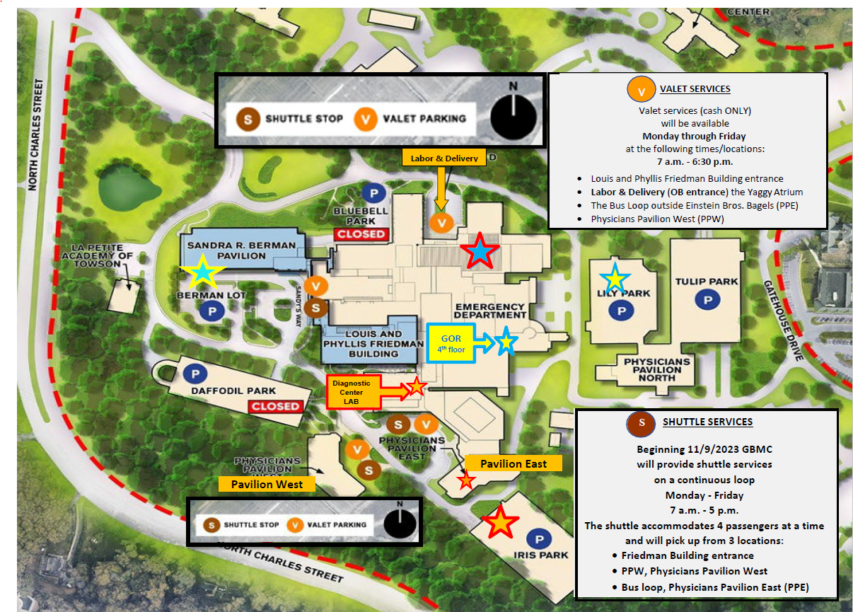

Slide 39
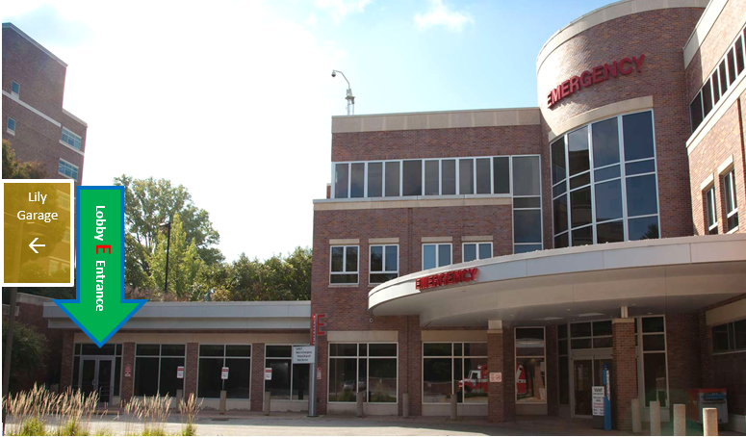
Arriving to the Hospital on the Day of Surgery
Arrive at the hospital at least 2 hours before your surgery time.
Park in Lily Garage.
Take elevator to the main floor to enter Lobby E.
Lobby E is on the 3rd floor of main hospital.
Notes:
GBMC’s Main Hospital Entrance will NOT be accessible due to renovation for the Promise Project.
All other COVID-19 visitation guidelines remain the same. The most up-to-date policies can be found at https://www.gbmc.org/policy or in PolicyStat.

Slide 40
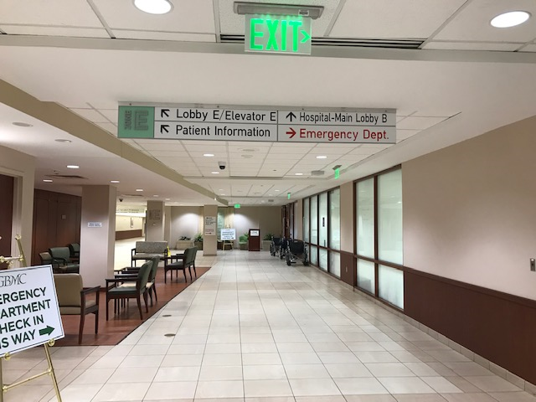
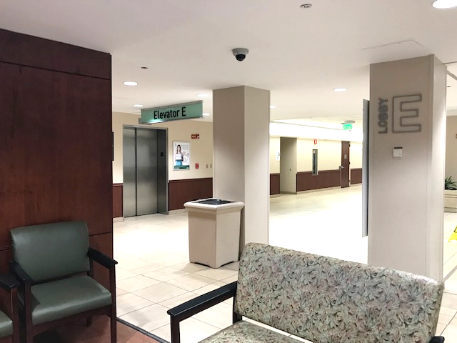
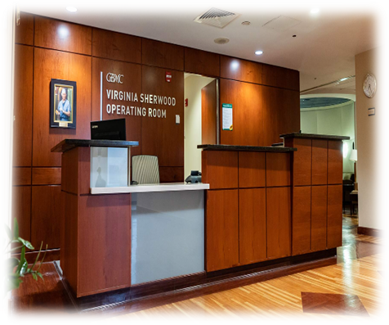
Directions to the General Operating Room (GOR)
Once inside, Lobby E, walk down the corridor, you will pass a sitting area on the LEFT.
Continue until you reach elevator E.
➢Take Elevator E on the left to the 4th floor
When you exit the elevator walk straight forward to the GOR registration desk.
Notes:
GOR: General Operating Room at GBMC - GBMC HealthCare in Baltimore, MD
Visiting hours update
All other COVID-19 visitation guidelines remain the same. They can be found at https://www.gbmc.org/policy or in PolicyStat.

Slide 41
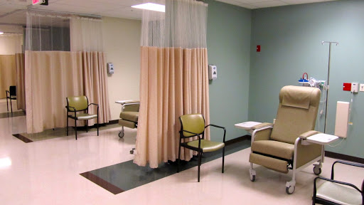
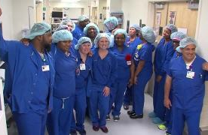
The Pre-operative/Intra-op Areas
In Pre-Op
You will be given a hospital gown to change into
You will be given in this pre-op area:
CHG wipes to clean your skin a 5th time
Nozin Nasal Sanitizer to begin your antimicrobial intranasal coverage
Meet your surgical team: surgeon, nurse, anesthesiologist, tech
Admission database will be completed
Vital signs, IV will be started; IV fluids and antibiotic(s)
Regional block
Notes:
Admission database: Many questions will be asked – “Do you know why you are here?” Don’t panic, they do know. They want to make sure you know and understand what procedure is being done

Slide 42
Pre-op Infection Prevention: antimicrobial intranasal coverage
Do you have an orange fruit oil allergy?
**This product will be given to you the morning of surgery in GBMC’s Pre-op Area.
Notes:
Nozin will be given to the patient at GBMC.

Slide 43
Types of Anesthesia, local blocks, multimodal pain management
Your anesthesiologist will discuss the types of anesthesia
Spinal anesthesia
A form of regional anesthesia involving the injection of a local anesthetic into the fluid surrounding the spinal cord in the lower back: this will numb the legs and block all sensation in the lower half of the body for several hours. You will be sedated and not awake.
General anesthesia
Anesthesia is inhaled though a breathing tube or mask: it affects the whole body and usually induces a loss of consciousness.
Adductor Block
An injection performed in the inner thigh to block sensation of surgery pain in the knee: the block wears off by 72 hours post operatively, other means of pain relief may be necessary.
PENG Block
An injection performed in pelvic region to block sensation of surgery pain in the hip: to help provide pain relief.
Joint Cocktail
A mixture of pain medication, local anesthetic, and anti-inflammatory injected into the knee or hip. To provide pain relief when the surgery is completed.
Notes:
Updated 2/24/2024
General Anesthesia versus Spinal Anesthesia? On the morning of surgery, shared decision-making conversation between patient and anesthetist will be discussed based on the patient’s H&P and other factors.
Intra-operative Medications (ERAS Policy STAT March 20, 2023. GBMC Orthopedic Knee and Hip ERAS Program, 12/16/2022, https://gbmc.policystat.com/policy/12825029/latest)
Antibiotics per GBMC Protocol
Ancef
Ancef and Vancomycin if MRSA (+) based on screening.
Clindamycin/gentamicin if Penicillin (PCN) allergy.
Tranexamic acid 1 g to be administered by the surgeon or the anesthesia team unless contraindicated.
Joint Pain Solution Pre-mixed by pharmacy (Ropivacaine—205 mg or 175 mg, Epinephrine 0.5 mg, Ketorolac 30 mg, Clonidine 0.08 mg).
Scopolamine Patch: for high risk of post-op nausea/vomiting. Do not give to patients with angle-closure [narrow angle] glaucoma.
Intra-Operative Anesthesia Options (ERAS Policy STAT 2023)
A. Spinal with Adductor Canal Block (KNEE ONLY)
Ultrasound guided Adductor Canal block, Ropivacaine.
B. General Anesthesia with Adductor Canal Block (KNEE ONLY)
Ultrasound guided Adductor Canal block, Ropivacaine.
C. Pericapsular Nerve Group (PENG) (Optional for HIP ONLY***)
Ultrasound guided pericapsular nerve group block, ***Ropivacaine.
Updated with pharm 6/29/2023

Slide 44
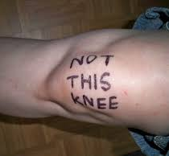
DO NOT…
Do NOT write on extremities before coming to the hospital
For example: “Wrong leg!” You and your surgeon will verify which knee or hip will be operated on.
Your surgical team will:
Actively communicate in the operating room; this check is called a TIME-OUT
During the time-out, the team members agree:
correct patient identity
correct site
procedure to be done

Slide 45
In the Operating Room
Surgery times are determined by the type of surgery:
Total knee or hip: 2 to 2.5 hours
Partial Knee: 1.5 to 2 hours
Bilateral knees: 4 to 5 hours
Knee or hip revision: 2.5 to 5 hours

Slide 46
After Surgery
PACU I (postanesthesia care unit)
You will wake up and probably feel sleepy
Your vital signs will be assessed every 15 minutes
Cardiac and oxygen monitors will be in place
Pain should be well managed with the nerve block and cocktail, but additional pain relievers are available as needed
Your anesthetist will evaluate your progress, once you have met the criteria for the next phase: vital signs are stable, pain is managed, you have sensation in operative leg, and the room you will be transferred to is clean:
GBMC’s pre-approved Same-Day patients will be begin the PACU II phase
GBMC’s 23-hour/admit patient will be transferred to Unit 58
Pre-approved Same-Day patients (Dr. Lanzo or Dr. Schmidt’s patients only)
PACU II phase for discharge home:
Meet your Registered Nurse (RN) and your assigned Physical Therapist (PT)
Your Nurse and Physical Therapist will provide teaching to you and your support person, they will evaluate you for discharge home.
You will be given an Ice Therapy Wrap to help relieve pain and manage swelling after surgery.
You will be given your post-op Nozin 12 mL bottle kit; your nurse will teach you how to apply and when to apply the Nozin. Your first dose will be given at this time.

Slide 47
Post-op Infection Prevention
First dose: after surgery upon arrival to PACU Phase II or Unit 58
Next dose: at 9 pm, then every 12 hours
Continue every 12 hours until your 1st post-op visit or until the bottle is empty (30 days)
Do you have an orange fruit oil allergy?
Notes:
Nozin will be given to the patient at GBMC.

Slide 48
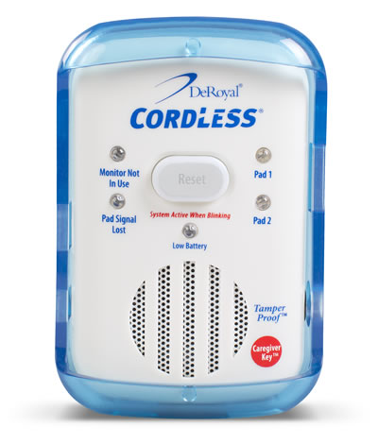
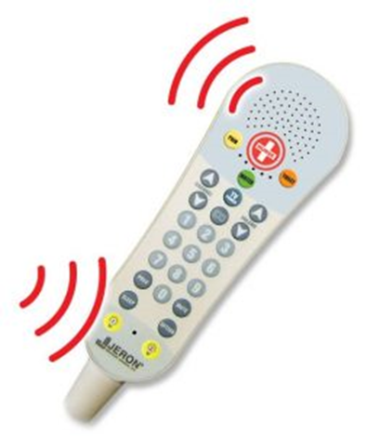
Fall Risk
Red non-skid socks will be placed on you, signaling that you are at a high risk for experiencing a fall
Do NOT get up without the help of staff assisting you.
Use your call bell

Slide 49
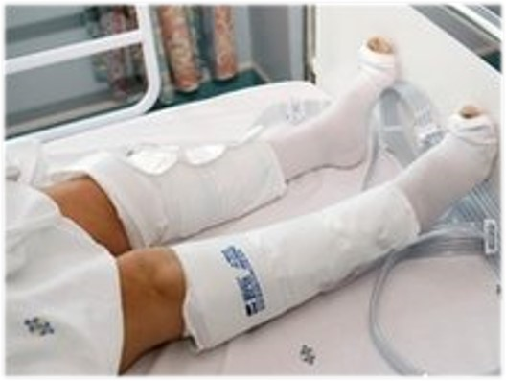
DVT Prevention: Sequential Compression Device
Optional: Portable SCD for Home Use:
Patient being discharged from Unit 58 only
$150 to billed by Precision Medical
Worn in the hospital
Used on your lower extremities to help promote circulation
Helps prevent post-op lower leg DVT (blood clot)
Accepting insurance companies (no out-of-pocket cost)
CAREFIRST BCBS, TRICARE, NALC
Out-of-pocket cost is $150:
BC Federal, Medicare/Medicaid, AETNA, United Healthcare, Johns Hopkins Advantage, University of Maryland Advantage, Amerigroup, or non-commercial insurance.
Payment plans can be arranged through Precision Medical Products, Inc.
Precision Medical will arrange payment with you (NOT GBMC)
All out-of-pocket sales are final, no cash/credit refund
Notes:
Accepting insurance companies (no out-of-pocket cost)
CAREFIRST BCBS, TRICARE, NALC
Workers Comp may cover the device
Out-of-pocket cost is $150:
BC Federal, Medicare/Medicaid, AETNA, United Healthcare, Johns Hopkins Advantage, University of Maryland Advantage, Kaiser Permanente, Amerigroup, or non-commercial insurance. ***TRICARE is the only secondary that is accepted
Payment plans can be arranged through Precision Medical Products, Inc.
Precision Medical will arrange payment with you (NOT GBMC)
443-845-1809
All out-of-pocket sales are final, no cash/credit refund
https://www.pmpmed.com/
GBMC J&S Center does not receive any financial incentives
Instructions for use: will be determined by your surgeon and given to you by the J&S Manager or your RN before you are discharged home. In addition to these instructions, you can Google search or use your internet search engine: “Circul8” for instructional videos to watch online: How To: CIRCUL8 PRO w light indicators on Vimeo https://vimeo.com/539918135Any issues with the device, call Precision Medical, the phone number is on the

Slide 50
DVT Prevention
Everyone will be prescribed an anticoagulant medication to help prevent blood clots
Aspirin, or
Eliquis tablets, or
Injections into the abdomen (only): education provided by nurse
Lovenox
Arixtra
Circul8 device (optional): notify your nurse so you can be taught how to use it before you are discharged
Your ability to do your exercises and ambulate is paramount in preventing a blood clot
Stay hydrated by drinking fluids
Avoid excessive time on your feet or with your legs dependent as this can cause lower leg swelling which can lead to blood clots
Notes:
Patients MUST pick up their prescriptions and take their medication as directed, DO NOT skip a dose of your anticoagulant.

Slide 51
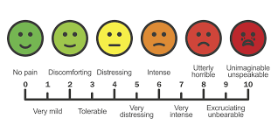
Pain Management
After surgery there will be bruising, swelling, and pain;
this is normal after a joint replacement.
Pain scale 0-10
“0” means no pain
“10” means the worst pain that you have ever had
Remember: You should not expect your pain level to be “0” after surgery
Pain medications are available as needed (prn)
Call your nurse when you are experiencing pain above your goal
Notes:
4-26-2024 After surgery there will be bruising, swelling, and pain; this is normal after a joint replacement.

Slide 52
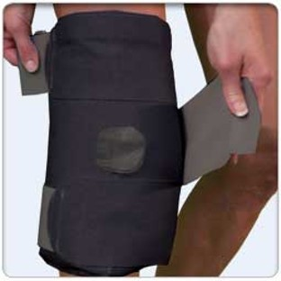
To Help Reduce Swelling and Discomfort
Ice packs and elastic wrap
2 packs of ice (hips)
4 packs of ice (knees)
Place on your operative joint after surgery
Elevated your leg when at rest
Knee: keep the knee extended/straight
Hip: be mindful of your hip precautions
Notes:
After surgery there will be bruising, swelling, and pain; this is normal after a joint replacement.
Paid for by Unit 58, these are for the patients to keep and bring home. Part of post-op pain management.

Slide 53
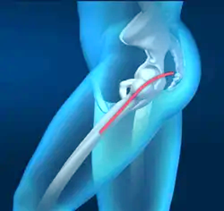
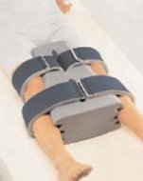
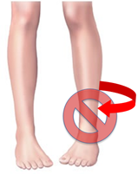
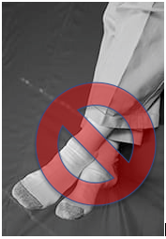
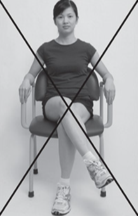
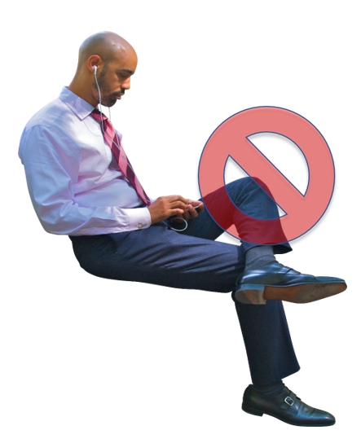
Hip Replacement Precautions:
Posterior Hip precautions
https://vimeo.com/showcase/10854689/video/815691264
Do not cross legs
Do not turn toes inward
Do not bend from waist beyond 90 degrees
Video
Abduction Pillow
Placed between legs while in bed to help prevent inward rotation
Notes:
Posterior Hip Precautions:
https://vimeo.com/showcase/10854689/video/815691264

Slide 54
…continued Hip Replacement Precautions videos:
Anterior Hip Replacement
Lateral Hip Replacement
https://vimeo.com/showcase/10854689/video/815690946
https://vimeo.com/showcase/10854689/video/815691026
Notes:
Anterior Hip Precautions:
https://vimeo.com/showcase/10854689/video/815690946
Lateral Hip Precautions:
https://vimeo.com/showcase/10854689/video/815691026

Slide 55
Total Knee Replacement
DO chair knee extensions.
Knee Precaution:
Do NOT place a pillow under your knee
Negative Outcomes
knee flexor contractures
prevents full knee extension
gait disturbances
DO place a towel roll under your ankle while in the bed or recliner chair.
Positive Outcomes:
Promotes knee extension

Slide 56
Medical Equipment Needs
If you have a rolling walker (RW) or received a RW from your surgeon’s office preop (Ortho MD), please bring it into the hospital.
If you do not have one, the team in the hospital will assist you in obtaining one.
Walker & walker bags
Made from a reusable grocery
Cut each handle
1x then tie around
the front of your walker bag
Approved
Not Approved
Walker Folding with Front 5" Wheels and ski/rear glide caps/tennis balls
Sew for Vets
Notes:
4/17/2024
If you have Medicare and received a rolling walker within the past 5-years, Medicare will not cover another, therefore you may have an out-of-pocket cost
11-8-2023 OrthoMD, Dr. Heller patients: “Dr. Heller will give all equipment and scripts when the patient goes to their pre-surgical review 1 week prior to surgery.”

Slide 57
Medical Equipment Needs to Consider
Bedside Commode
Tub/Shower Chair
Raised Toilet Seat
Toilet Safety Frame
Bedside commode
Can be used next to your bed
Can be used as a shower chair for your walk-in shower
Tub Seat/Shower Chair
Decreases the risk of falls in the shower or tub
Allows you to safely sit while showering if you have pain or dizziness
Shower doors on bathtubs may need to be removed
Raised toilet seats, bedside commodes, and toilet seat frames
Important for those who have had a posterior approach total hip replacement
Raise the height of your toilet
Notes:
Shower chair
To decrease risk of falls in the shower or tub
If you get tired easily
If you have pain while standing
Toilet Safety Frame
To make it easier to stand or sit from the toilet using your arms
Bedside Commode
To elevate height of your toilet or to keep next to your bed if needed.
Can be used as a shower chair if you have a walk-in shower.
Important for those who have had a posterior approach total hip replacement.
Walker Bag - To carry items needed for dressing or to transport items such as food/drinks
Made from a reusable grocery bag
Cut each handle
1x then tie around
the front of your walker

Slide 58
Goals for Same-Day Discharge Home:
Self Scheduled Outpatient PT appointments are in place.
Medically stable (vital signs within normal limits, pain managed).
Coach/Family member present for education and training.
Cleared by your PT (ambulate with your walker and go up and down steps safely and appropriately, etc.).
Given the final clearance for home by your surgeon.
You and your Coach/Support Person will be given Home Discharge Instructions (AVS) and post-op supplies by your nurse.
← Please bring to the hospital your Day of Surgery Checklist
Notes:
Updated 3-28-2024: Same Day Discharge PATIENTS MUST Schedule their own Outpatient PT before their surgery. Start of Care should be 24-48hr from Discharge Date. There is not a case manager available to set this up.

Slide 59
PRESENTATION FOR SAME-DAY DISCHARGE ENDS NOW. Thank you for choosing GBMC!
Presentation Continues for 23-hour Observation/
In-Patient hospital stay Admission to Unit 58
Outpatient Total Joint Replacement additional resource:
https://orthoinfo.aaos.org/en/treatment/outpatient-joint-replacement-surgery/
Notes:
Updated 3-28-2024: Same Day Discharge PATIENTS MUST Schedule their own Outpatient PT before their surgery. Start of Care should be 24-48hr from Discharge Date. There is not a case manager available to set this up.
Updated 2-27-2024: Outpatient Total Joint Replacement additional resource:
https://orthoinfo.aaos.org/en/treatment/outpatient-joint-replacement-surgery/

Slide 60
Hospital Admission:
23-hour observation/
in-patient admit
Once your vital signs are stable, pain is managed, and you have sensation in operative leg(s). Your anesthetist will clear you for transfer from the PACU to Unit 58.
Unit 58 is located on the 5th floor of Zone D (Labor & Delivery entrance)

Slide 61
Admission to Unit 58
Private room
Meet your RN (Registered Nurse) and NST (Nurse Support Tech)
Communication Board updated
Ice wrap, Welcome Folder, and your Nozin 12 mL bottle kit will be given to you when you arrive to U58.
Upon arrival, the nurse will be teaching you how to give yourself a dose of Nozin from your home kit.
Meet your Physical Therapist (PT) or Occupational Therapist (OT)

Slide 62
Visitor Policy: Inpatient Adult Units
4 visitors are allowed at a time, 1-visitor can stay overnight (9p-8a).
Visitors 10-17 years must be accompanied by an
adult over 18 yrs. Visitors under 10yrs are not allowed.
Visiting Hours 8a-9p
Visitors must not be within the first 10 days of positive Covid-19 test
Visitors with any respiratory symptoms must wear a mask covering the nose and mouth at all times
Visitors must remain at the bedside and use the call-bell for all patient requests
If you require an ADA exception, please call the Joint & Spine Center
Notes:
5/15/23; https://gbmc.policystat.com/policy/13655025/latest/
3/23/2023 update on visitor policy; via NPAC Meeting Minutes.
Item #1 Security/Workplace Violence section, “……Covid is no longer a reason to stay restricted. In the State of Maryland, you have the right to have 1 person stay with you as a support person as long as they are not a disruption to the unit.”
Effective: 11/10/2022, updated 5/11/2023
https://www.gbmc.org/visitor-policy
Inpatient Adults
Visiting hours are now from 8am — 9pm, unless otherwise specified
One visitor may stay with the patient overnight (9pm — 8am), unless otherwise specified
No more than four visitors may enter the patient room at one time, unless otherwise specified
Visitors aged 10 to 18 years old will be allowed to visit with a responsible adult, unless otherwise specified
Visitation guidelines will reflect our Zero Tolerance policy as it relates to disruptive behavior
There will be no limitations on visiting COVID-19 patients, but visitors will be required to comply with all infection control guidelines including wearing personal protective equipment
Visitors with a previous positive COVID-19 test may visit once they have been cleared per CDC guidelines for healthcare settings (these guidelines are different than community guidelines)

Slide 63
Physical and Occupational Therapy Starts the Day of Surgery
You may be evaluated by a physical therapist (PT) or occupational therapist (OT) when you arrive to Unit 58 (Friday cases)
Late cases, you will meet your PT/OT on POD#1
You will learn to walk with a walker around the unit, go up and down steps, and/or learn to get out of a model car, or in/out of a shower tub.
If you are not seen by a PT or OT, the nursing staff will walk you from the chair to bathroom before midnight.

Slide 64
Rehabilitation: PT versus OT
Physical Therapy: helps you with functional mobility
Walking
Getting in/out of bed
Transfers into/out of a chair
Going up/down steps
Doing your exercise program
Occupational Therapy: helps you with functional activities of daily living (ADL)
Getting dressed and bathed
Getting in/out of tub/shower
Using the toilet
Car transfers
How to use adaptive equipment if needed
Getting items out of refrigerator/cabinets

Slide 65
Physical and Occupation Therapy: Their Assessment and Education
Social information: Do you live alone or have help?
Environment during recovery:
Do you live on one level or more?
Number of steps inside/outside home?
Are there railings?
Bathtub or shower equipment?
Take pictures of your bathroom, kitchen, living room, etc.
Prior level of function: How were you doing before you came into the hospital?
Rolling walker: If you have a walker bring it with you on the day of surgery, they will ensure proper fit and condition.

Slide 66
Medical Equipment to help prevent hip dislocation. Hip Kit may include one or more of these items:
Long Shoehorn
Reacher
Long Handled Sponge
Sockaid
Leg lifter
These items are available to your GBMC therapists

Slide 67
Medical Equipment Needs
Your PT and OT will assess, evaluate, and determine what (if any) assistive devices are needed at home to help prevent a hip dislocation after a posterior hip replacement:
Reacher**
Sock aid**
Long handled shoehorn**
Long handled sponge**
Leg lifter**
Dressing stick
Bedside commode
Raised Toilet Seats
Toilet Safety Frame
Tub seat
Elastic shoelaces
Equipment is usually not covered by insurance
Shower doors on bathtubs may need to be removed
**These items are available to your GBMC therapists

Slide 68
GBMC Care Management: GBMA Surgeons Drs. Schmidt, Lanzo, Johnston, and Melegari
The Care Manager (CM) on Unit 58 will visit you the day after your surgery to continue working on your discharge planning needs and offer you resources. Your post-op physical therapy aim is to continue your home exercises independently every day, 2-3 times a day. Your CM will help you arrange a PT session within 72-hours after discharge from the hospital, every attempt will be made to meet this goal.
Home with Home Physical Therapy: Your GBMC inpatient CM will help to arrange your home PT if your inpatient therapists are recommending home PT. Do Not LEAVE the hospital until an accepting agency is arranged.
Home PT is limited to your insurance approval, service area, an available home therapy group, and availability of a physical therapist. Please be aware that during the holidays or weekends, staffing for home PT or outpatient PT is limited.
Home with Out-Patient Therapy: Please write down the appointment date, time, and the outpatient therapy group in your Guidebook. Your GBMC physical therapist (PT), occupational therapist (OT), and CM will want to know this information.
This maybe set-up in advance by the Ortho Care Coordinator, Tori Schmitz, in the GBMA Orthopaedic Office.
Designate who is driving you to your appointment
Equipment for home: Please let your GBMC PT/OT/CM know if you need a walker for discharge. Insurance authorization is needed. If you had a previous joint replacement, please bring in your walker on the day of surgery.
Discharge is between 1pm-5pm
Skilled Nursing Facility (SNF): Medical necessity and insurance authorization approval needed. If your insurance denies discharge to a subacute or acute rehab center, you will be discharged home.
Notes:
Drs. Schmidt, Lanzo, Melegari, and Johnston
GBMC CM will visit you in your hospital room the morning after surgery to discuss discharge plans for home or other arrangement, home physical therapy or outpatient physical therapy, and equipment (walker, etc).
Your post-op physical therapy aim is to continue your home exercises every day, 2-3 times a day.
Your CM will help you arrange a PT session 72-hours after discharge from the hospital, every attempt will be made to meet this goal.
Most home PT occurs once or twice a week for 20-30 minutes.
Patient planning to be discharged home and going to Out-Patient Physical Therapy: Schedule your appointment TODAY or as soon as possible to secure a date within 72-hours after discharge.
Example: if the plan is for discharge home on a Tuesday, schedule your PT appointment for Wednesday or at the latest on Thursday. Please be aware that during the holidays or weekends, staffing for home PT or outpatient PT is limited.
Patients are expected to do their exercises 2-3 times a day independently with or without a therapist.
Once all discharge criteria are met (home PT or outpatient PT, delivery of walker to room, and/or medications delivered to room) the patient is typically discharged between the hours of 1pm-5pm.

Slide 69
GBMC Care Management: OrthoMD Patients Drs. Buchalter, Jay, and Heller
Your post-op physical therapy aim is to continue your home exercises independently every day, 2-3 times a day.
The Care Manager (CM) on Unit 58 will visit you the day after your surgery to continue working on your discharge planning needs and offer you resources.
Home with Home Physical Therapy: On post-op day #1, your GBMC inpatient CM will help to arrange your home PT if your inpatient therapists are recommending home PT. Do Not LEAVE the hospital until an accepting agency is arranged.
Home PT is limited to your insurance approval, service area, an available home therapy group, and availability of a physical therapist.
Your CM will help you arrange your home PT session within 72-hours after discharge from the hospital, every attempt will be made to meet this goal. Please be aware that during the holidays or weekends, staffing for home PT or outpatient PT is limited.
Home with Out-Patient Therapy: Before your surgery date, your OrthoMD team will schedule your outpatient physical therapist (PT) session two-weeks after surgery. Write down the appointment date, time, and outpatient physical therapy agency into your Guidebook.
Designate who is driving you to your appointments
Equipment for home: Patients will be fitted with a rolling walker (2-wheels) at an OrthoMD clinic. If you did not receive a walker from OrthoMD, please let your GBMC therapists and CM know you need a walker for discharge. Insurance authorization is needed.
Dr. Heller’s patients will receive equipment and scripts when the patient goes to their Pre-surgical Review 1-week prior to surgery.
Discharge from the hospital is between 1pm-5pm
Skilled Nursing Facility (SNF): Medical necessity and insurance authorization approval needed.
If your insurance denies discharge to a subacute or acute rehab center, you will be discharged home.
Notes:
Drs. Buchalter, Jay, and Heller
GBMC CM will visit you in your hospital room the morning after surgery to discuss discharge plans for home or other arrangement, home physical therapy or outpatient physical therapy, and equipment (walker, etc).
Your post-op physical therapy aim is to continue your home exercises every day, 2-3 times a day.
Your CM will help you arrange a PT session 72-hours after discharge from the hospital, every attempt will be made to meet this goal.
Most home PT occurs once or twice a week for 20-30 minutes.
Example: if the plan is for discharge home on a Tuesday, schedule your PT appointment for Wednesday or at the latest on Thursday. Please be aware that during the holidays or weekends, staffing for home PT or outpatient PT is limited.
Patients are expected to do their exercises 2-3 times a day independently with or without a therapist.
Once all discharge criteria are met (home PT or outpatient PT, delivery of walker to room, and/or medications delivered to room) the patient is typically discharged between the hours of 1pm-5pm.

Slide 70
Medical Orders for Life-Sustaining Treatment (MOLST)
MOLST
Portable medical order form covering options for cardiopulmonary resuscitation and other life-sustaining treatments
Does not expire
Medical orders are based on a patient’s wishes about medical treatments
The advance practitioner or surgeon will have the paperwork.
Not Advance Directives
All patients that are transferred to another facility will require a MOLST form prior to EMS transport
Notes:
THIS is a Maryland mandate for those who are discharged to a subacute rehab.

Slide 71
Discharge Day
Once all discharge criteria are met:
Coach/Support Person Training completed.
Cleared by your PT/OT.
Cleared by your surgical and/or medical team for discharge home.
Your GBMC In-patient Care Manager:
Has confirmed postoperative physical therapy arrangements.
You have a walker with 5” wheels, 2 back slide caps or skis.
If not done prior to surgery, a prescription will be sent electronically to your pharmacy
Nurse has reviewed your discharge paperwork with you.
Discharged home is typically between the hours of 1pm-5pm. You must have a walker and a ride home with a family member, friend, or care companion.
Notes:
Updated 4-17-2024
Once all discharge criteria are met the patient is typically discharged between the hours of 1pm-5pm. You must have a walker and a ride home with a family member, friend, or care companion.
If you have a rolling walker (RW) or received a RW from your surgeon’s office Preop (Ortho MD), please bring it into the hospital. If you do not have one, the team in the hospital will assist you in obtaining one.

Slide 72
Discharge Instructions
Your discharge nurse will provide verbal and written discharge instructions from your surgeon located on the printed After Visit Summary packet:
Blood Clot Prevention, Signs & Symptoms:
medication and activity
Medication(s) ordered by your surgeon:
pain management, preventing constipation, etc.
Surgical Dressing and Wound Care.
Activity:
physical therapy, ice and ice wrap, and precautions
Follow Up and When to Notify Your Surgeon’s Office.
Notes:
Updated 1/30/2024

Slide 73
Notes:
**Kaiser Permanente patients are not to shower for two weeks (per KP Coordinator)

Slide 74
Thank you for
choosing GBMC
for your Joint Replacement!
Joint and Spine Center
6701 N Charles St
Towson, MD 21204
Phone: 443-849-6261
Email: jointspinecenter@gbmc.org
Website: www.gbmc.org/JointandSpine
ACTIVATE your MyChart today
Notes:
MyChart: MyChart at GBMC - Patient Portal - GBMC HealthCare - Towson/Baltimore, MD

Slide 75
Notes:
Updated 2-23-2024
GBMC will offer a patient and visitor shuttle as well as additional valet services to assist in campus transportation and wayfinding until the Sandra R. Berman Pavilion opens in early 2025. Please familiarize yourself with the valet and shuttle locations and schedule below so you can educate patients and visitors as needed.
VALET SERVICES
Valet services will be available Monday through Friday at the following times/locations:
7 a.m. - 6:30 p.m.
Louis and Phyllis Friedman Building entrance
Labor & Delivery (OB entrance, Lobby D) at the Yaggy Atrium
The Bus Loop outside Einstein Bros. Bagels (Note: Valet service at this location will end once the Berman garage opens for patient and visitor parking later this year.)
8:30 a.m. - 5 p.m.
Physicians Pavilion West (PPW
SHUTTLE SERVICES
GBMC will provide shuttle services on a continuous loop Monday through Friday from 7 a.m. – 5 p.m. beginning 11/9. The shuttle can accommodate 4 passengers at a time and will pick up from the Friedman Building entrance, PPW, and the bus loop.

