Slide 1
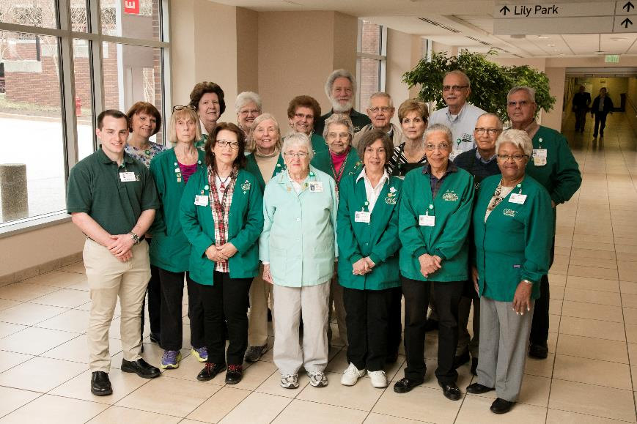
GBMC Volunteer Orientation

Slide 2
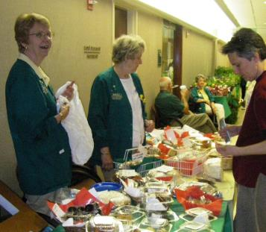
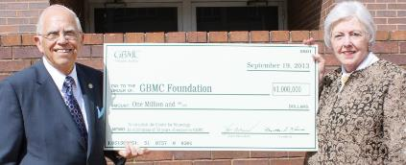
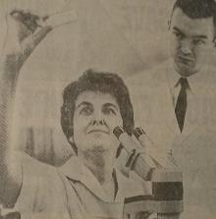
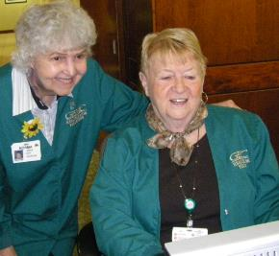
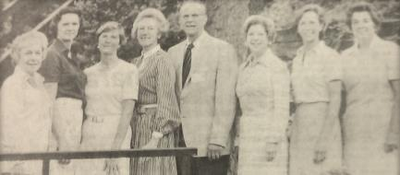

Can’t do this without you
Since 1963 volunteers have been the voice of the community!
Helping with major fundraising in support of patient care
Exemplifying the values of the hospital

Slide 3

Purpose of Orientation?
Hospitals are highly regulated and inspected
  Joint Commission (JC) is key regulator
All staff, including volunteers must complete an Orientation
  Covering regulation and policy
Required documentation to prove compliance
Want you to be informed, safe and comfortable in this environment

Slide 4

Orientation Training Plan
Presented in 3 parts
Regulation and Policy Training – online
    Regulatory – ‘HAFTA’
    Patient Experience
Hands On and Review - classroom

Slide 5
Part 1 - Logistics
Slides – show key points
Volunteer Services Handbook – written reference
  https://www.gbmc.org/volunteer-services-handbook
  Password is 6701
Online Test
Online Acknowledgement Form
Online Greater Behaviors Commitment Form

Slide 6

Topics – Regulation
Joint Commission & Volunteer Requirements
Ergonomic Hint
Safety
HIPAA
Stroke
Infection Prevention
Patient Identification
Corporate Policies
Hospital Policies

Slide 7

Joint Commission (JC)
Key GBMC hospital regulator
  JC sets the ‘gold standard’
  Does onsite ‘inspections’ minimum once every 3 years

Slide 8

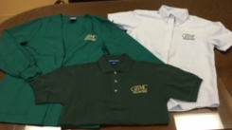
Joint Commission - Requirements for Volunteers
General Orientation to include specific subjects
Additional clinical training by a clinician if in clinical role
Annual renewal training (August of each year)
Assessment minimum of once every 3 years
Service Description for each volunteer role
Health Screening
Uniform Requirements (badge, uniform, mask)

Slide 9

Body Mechanics/Ergonomics
We would be remiss if we did not remind you of this rule!
For every 20 minutes of the same or static posture or activity, take a 20 second rest or stretch break.
Get out of your chair every 30 to 60 minutes.

Slide 10
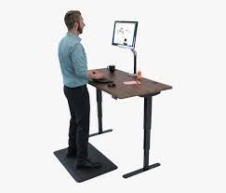


Body Mechanics/Ergonomics
Lifting
Working at a Desk
Standing for Extended Periods

Slide 11
SAFETY
Hospital Codes
  Explained
  Special attention for ‘FIRE’
Please read Volunteer Services Handbook section on Safety Codes

Slide 12
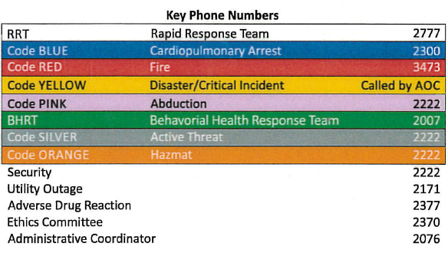
SAFETY – Hospital Codes
SAFETY BADGE ISSUED TO ALL VOLUNTEERS
443-849-

Slide 13
SAFETY – RRT and Code Blue
Called when a patient/visitor is in medical distress
  RRT (Rapid Response Team)
    Patient breathing
    Patient showing signs of a STROKE*
  Code Blue
    Patient is not breathing
*Term ‘STROKE ALERT’ is used.

Slide 14
SAFETY – RRT and Code Blue
Callers must be prepared to answer:
What kind of emergency?
  Rapid Response, Code Blue or Stroke Alert
Who needs help?
  Adult, child or newborn?
  Inpatient or Outpatient*
Where is help needed?
  Name of building, Floor#, Room#, description of location
  Exceptions are locations where there is no way to safely transport a person on a stretcher or wheelchair. This includes: Nearly New (Farmhouse Hill), Gilchrist, La Petite, South Chapman, and the warehouse. 911 should be called at these locations.
A medical team plus Security will respond to the call. If it is a ‘STROKE ALERT’, a Hopkins stroke neurologist will also respond.
*Outpatient includes: visitors, volunteers, employees

Slide 15



SAFETY – RRT and Code Blue
What should volunteer do?
Stay with patient until help arrives
  Helps to reassure the patient
  Helps to let others know that help has been called
  Gives you the opportunity to wave over the response team
Once team arrives
  Get out to the way, you have done your duty
  In some unit assignments volunteers help with patient privacy

Slide 16

SAFETY – Code Red - Fire
What should volunteer do in the event of a fire?
Evacuation
  Inside Hospital
    Stay where you are unless instructed otherwise
    Hospital is constructed with automatic fire suppression and ‘smoke compartments’
  Everywhere else
    Evacuate immediately
Safety Badge (shown on next slide)
  SAVE – procedure in the event of a fire
  PASS – How to use a fire extinguisher
Useful FACT: GBMC fire extinguishers are rated for Class ABC fires (wood, paper, clothing, gas, grease, oil and electrical)

Slide 17
SAFETY – Code Red
SAFETY BADGE ISSUED TO ALL VOLUNTEERS

Slide 18
SAFETY – Code Red - Fire
Questions regulators may ask:
Where is the closest fire extinguisher?
Where is the closest fire alarm pull?
What is the evacuation policy and route for your area?
Where is the ‘Emergency Preparedness Guide’ (pictured on next slide) for your area?

Slide 19
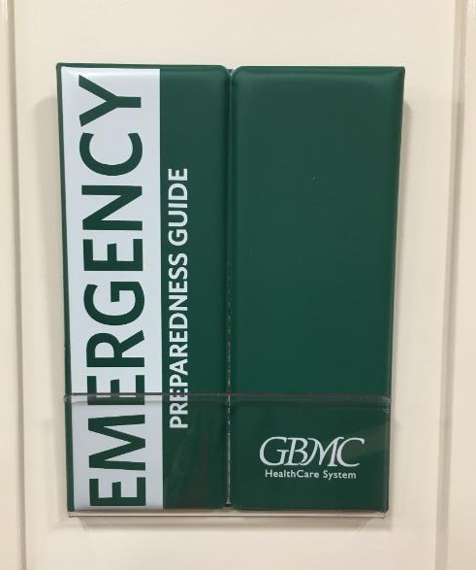
SAFETY –
Emergency Preparedness Guide
Found at eye level throughout the hospital
Has location specific information like evacuation routes

Slide 20
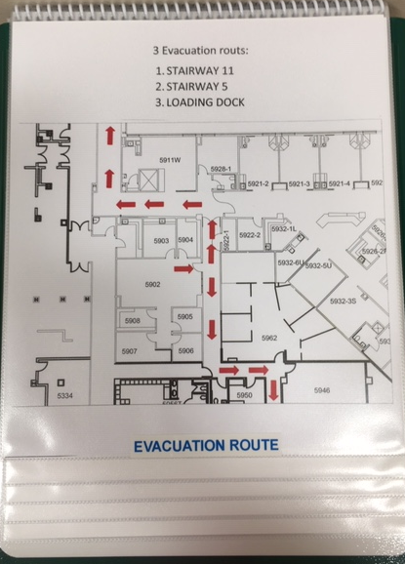
Emergency Preparedness Guide -
Evacuation Route Guide

Slide 21
SAFETY – Code Yellow – Disaster/Critical Incident
Hospitals must have Emergency Operations Plans in place in the event normal operations are disrupted by internal or external events.
When these occur, Code Yellow is called. The Command Center will be responsible for providing ongoing communication.
Volunteers must be diligent in signing in and signing out when on duty. During an emergency, this makes it possible for Volunteer Services to determine who is volunteering.

Slide 22
SAFETY – Code Pink – Infant/Child Abduction
All pediatric areas within the hospital are closely monitored with strict ID badge access.
This code is called in the event of a child abduction.
Employees disperse to all exits, elevators and stairwells to monitor unusual behavior and check bags.
Volunteers are asked to report observations and departures may be delayed.

Slide 23
SAFETY – Code BHRT – Behavioral Health Response Team
In response to disruptive and potentially violent behavior a team made up of a Behavioral Health Nurse, the Nursing Coordinator and Security respond.
Volunteers are asked to remove themselves from the situation.
This was formerly known as Code Green.

Slide 24
SAFETY – Code Silver –
Active Threat
This is used to warn of violence by an active shooter or armed assailant. Information is taken from Homeland Security guidance.
Personal strategies are to RUN, HIDE or FIGHT. Do not let others influence your choice!
Please read the Volunteer Service Handbook for more detail and Homeland Security references.

Slide 25

SAFETY – Code Orange – Hazardous Material
Dangerous chemicals and radioactive material are in the hospital.
They are stored in specialized containment areas and handled by experts. Required safety protocols are in place.
Volunteers and employees are made aware of this code for the sake of completeness.

Slide 26

SAFETY – Security
The Security Department recognizes that everyone has a different tolerance for safety risk.
Volunteers are asked to ‘err on the side of caution’ and should be comfortable reaching out to Security.
This is also true in the event suspicious behavior is observed. ‘See something, say something.’

Slide 27
SAFETY – Volunteer Services Handbook
Please read Volunteer Services Handbook
  More detail on the information presented
  Additional information on:
    Latex
    Fall Risk
    Tailgating, Piggybacking
    Weapons Policy

Slide 28
HIPAA – Federal Law
HIPAA stands for
Health
Insurance
Portability &
Accountability
Act

Slide 29
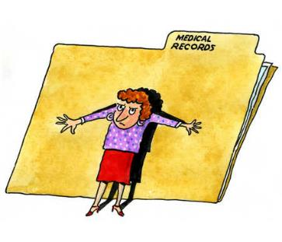
HIPAA – Federal Law
Law restricts the use and disclosure of patient information.
Applies to volunteers!
There are 3 key principles.

Slide 30

HIPAA – Protected Health Information
This is any piece of information which can be used to identify an individual person.
With tools like ‘GOOGLE’ information as subtle as a license plate number can be used to identify an individual.
Tattoos and birthmarks would also qualify!

Slide 31
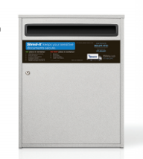
HIPAA – Protected Health Information
If information comes from a hospital, the assumption will be made that it is health information
Examples: names, medical record/insurance/social security numbers, home/email addresses
Regardless of where you are helping, all documents with personal information should never go in the wastepaper basket.
They must go in the shredder box.

Slide 32


HIPAA –
Treatment, Payment, Operations
Information can only be shared in the context of the duties performed as a volunteer
Anything outside of this scope requires signed permission from the patient
Sharing or using information about a patient outside of the hospital as a result of something learned while on duty is outside of these parameters

Slide 33

HIPAA – Minimum Necessary Rule
We are only given the minimum information to perform our duties.

Slide 34
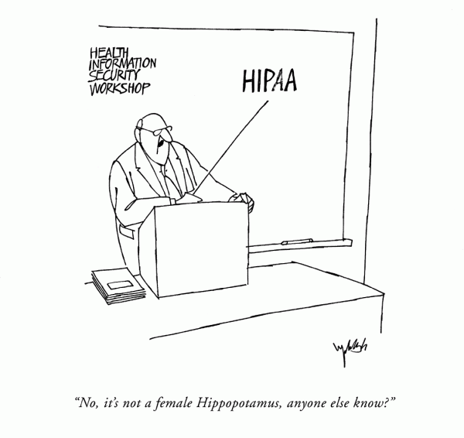
HIPAA – Testing Knowledge
We’ll put these principles to the test in the classroom portion of the Orientation.
Please read Volunteer Services Handbook on HIPPA
“No, it’s not a female Hippopotamus, anyone else know?”

Slide 35

STROKE
Occurs when a clot or burst blood vessel interrupts the flow of blood to the brain
Volunteers must be able to recognize the signs of a STROKE and know what to do

Slide 36

STROKE – F.A.S.T.
Face
  Face looks uneven
  Unable to smile
Arm
  Arm drifts down
  Unable to raise both arms
Speech
  Speech sounds strange
  Unable to repeat a phrase
Time
  Brain cells die every second
  Call Rapid Response and use the phrase ‘STROKE ALERT’ in hospital areas
  Call 911

Slide 37
STROKE – Sudden Symptoms
A STROKE can manifest in other sudden ways:
  Weakness and numbness on one side of the body
  Confusion, trouble speaking or understanding
  Trouble seeing
  Trouble walking or loss of balance
  Severe headache

Slide 38
STROKE – Transient Ischemic Attack
When stroke symptoms appear and disappear, this is called a TIA.
Immediate medical attention is need to help prevent a major stroke.
Please read Volunteer Services Handbook on STROKE information

Slide 39

INFECTION PREVENTION
Disease Information
  Tuberculosis (TB)
  Influenza (FLU)
Infection Prevention Practices
  Handwashing
  Cough Etiquette
  Social Distancing
  Disinfecting
  Masks
Transmission Based Precaution Signs
Please read Volunteer Services Handbook on Infection Prevention

Slide 40

Tuberculosis (ACTIVE & LATENT)
Infectious bacterial disease that mainly affects the lungs
ACTIVE TB symptoms include persistent: coughing, fever, night sweats, fatigue, chest pain
A person who carries the pathogen but has no symptoms has LATENT TB
A person is infectious to others only when they have ACTIVE TB

Slide 41

Influenza - FLU
A viral infection spread by droplets sent thru the air by coughing, sneezing or touching surfaces with virus on them*
Symptoms include: fever, chills, sore throat, muscle aches, fatigue, cough, runny nose, headache
CDC says: ‘The best way to prevent the FLU is by getting vaccinated each year.’
All volunteers must get a FLU shot annually
*Virus survives for 24 hours on surfaces

Slide 42

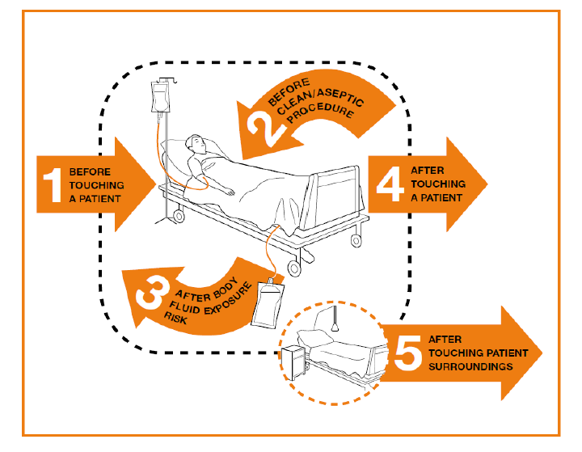
Handwashing
5 Moments of Hand Hygiene
4 out of 5 apply to volunteer activity

Slide 43
Handwashing
Minimum Requirement
  WASH IN before entering patient room/treatment area
    Protects patient
  WASH OUT after exiting patient room
    Protects you
  EXCEPTIONS:
    Hands full with a delivery or equipment?
      Enter room, place item down, then WASH IN

Slide 44

Handwashing
Soap and Water
  Must be used when hands are visibly soiled
  Minimum of 20 seconds
Hand Sanitizer (with minimum 60% alcohol)
  Found throughout hospital and particularly at entry to every patient room
  Rub hands until dry (approximately 20 seconds)

Slide 45

Handwashing
WASH IN / WASH OUT is monitored and counted!
  Counts are taken by unit/department and role
  Reported monthly and is a hospital quality and safety metric
  Monitors will approach non-compliant employees and volunteers to offer reminders and coaching
COMPLIANCE GOAL set annually

Slide 46
Handwashing –
Soap and Water
  Must be used when hands are visibly soiled
  Minimum of 20 seconds
Hand Sanitizer
  Found throughout hospital and particularly at entry of every patient room
  Rub hands until dry (approximately 20 seconds)

Slide 47

Handwashing
The following video shows handwashing technique for soap and water. It also applies when using hand sanitizer.
Minimum scrub time is 20 seconds!
HINT: Be sure to remove jewelry!
?? Which is more important for safety: TIME or TECHNIQUE?
TECHNIQUE!

Slide 48


Slide 49
Handwashing – WHEN?
Always, WASH IN and WASH OUT of patient rooms and treatment areas
Before putting on and after removing gloves
Before putting on and after removing face masks
When moving from a ‘dirty’ task (garbage) to ‘clean’ task (typing)
As you enter and exit the hospital
As you enter and exit your assignment area
As necessitated within your assignment (example, between customers in the Corner Shop)
As you get into your car

Slide 50

Handwashing – Important Notes
Fingernails?
Natural nails less than ¼ inch long recommended
  Especially in surgical and intensive care areas
Polished and artificial nails have been shown to carry more pathogens

Slide 51






Respiratory Hygiene/Cough Etiquette
Cover mouth/nose with tissue when coughing or sneezing
Promptly dispose of used tissues
No tissue? Cough/sneeze into your elbow not your hands
Use a face mask to protect others
Perform hand hygiene after contact with respiratory secretions
Practice “spatial separation” (maintaining a distance of at least 6 feet from other persons)

Slide 52
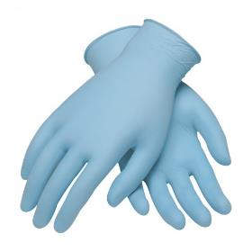
Disinfection Practices
All clinical areas have disinfection routines
Volunteers will learn how to contribute to this team effort
Each disinfection product has specific instructions
For your protection, be sure to wear gloves when using the products

Slide 53
Disinfection Practices
The various wipes have different ‘dwell times’
‘Dwell time’ is the length of time a disinfectant must remain on a surface to kill germs effectively
Here are two examples:
  Purple-top wipes (2 minutes)
  Grey-top wipes (3 minutes)
  HINT: dwell time is usually on the packaging

Slide 54
Volunteer Practice and Regulation
‘Clinically Hands Off the Patient’
Patient Identification
  Name and Date of Birth
Transmission Based Precautions
  Volunteers may only enter Standard Precaution Rooms

Slide 55
Regulation Brochure – given at interview
Defines ‘Clinically Hands Off the Patient’
  Volunteer roles do not have licensure
Spells Out Patient Identification
  At GBMC: Name and Date of Birth
Summary of all applicable regulation and policy
  Plus corporate culture and practices
Volunteer limitations
  Transmission Based Precautions

Slide 56
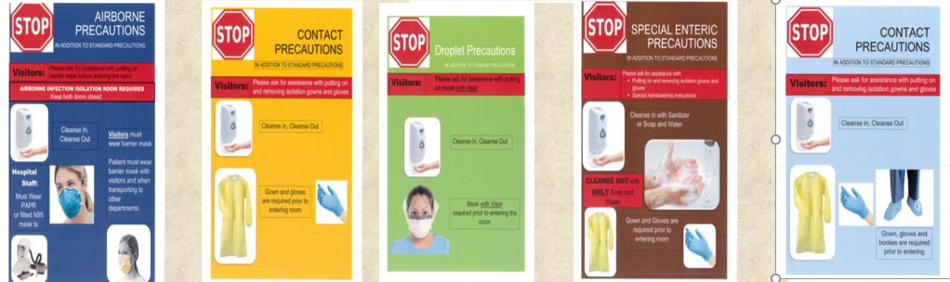
Transmission Based Precautions
Used when patient has an actively transmittable illness
A 2nd tier of infection prevention
Protocols vary depending on transmission mode
Signs will be prominently placed at a patient’s door
Volunteers do NOT enter these rooms

Slide 57
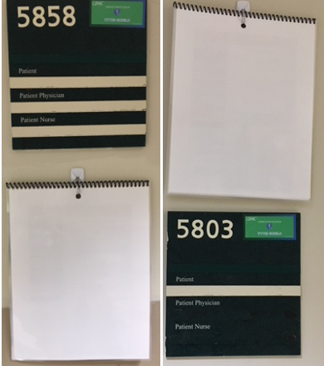
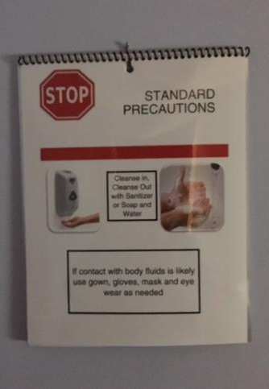
Standard Precautions
Volunteers may enter
Signage appears as follows

Slide 58

Corporate Policies
The following Corporate Policies apply to everyone and must be acknowledged annually:
Code of Business Ethics
Appropriate Use Agreement
Confidentiality of Information Agreement
The online Acknowledgement Form confirms you have read these policies. Please be sure to complete it!

Slide 59
Code of Business Ethics – Volunteer Summary
  Tips cannot be accepted. If someone insists please bring tips to the Volunteer Office where they will be deposited into the Volunteer Auxiliary fund raising account
  Volunteers cannot profit from relationships within the hospital
  Requirement to complete competencies and acknowledgements annually

Slide 60
Appropriate Use Agreement – Volunteer Summary
  Looking thru systems to satisfy curiosity would be an inappropriate use
  Looking for personal medical records in other than your own Patient Portal (My Chart) that would also be a violation

Slide 61
Confidentiality of Information Agreement – Volunteer Summary
  Reiteration of privacy of Protected Health Information
  Not sharing passwords and computer access
  Not sharing GBMC operational information

Slide 62
Corporate Policies
The online Acknowledgement Form confirms you have read:
Code of Business Ethics
Appropriate Use Agreement
Confidentiality of Information Agreement

Slide 63

Workforce Policies
Volunteers are considered part of the ‘workforce’ at GBMC.
Policies which apply to employees also apply to volunteers.

Slide 64
Workforce Policies
Just Culture
  Coach for improvement versus punishment
Diversity & Inclusion
Anti-Harassment, Discrimination, Retaliation and Bullying
  Not tolerated
Substance Abuse
  Response to occurrence
Please read Volunteer Services Handbook on Hospital Policies

Slide 65

Incident Reporting
Incident = an event that is not consistent with desired operation of organization and/or patient care
Report ‘actual’ and ‘near miss’ incident
Used to improve hospital safety
Formal system (QUANTROS, RL DATIX) with protocols
Volunteers may be asked to contribute to the reporting and follow-up

Slide 66
Volunteer Injury
If you are injured while on duty…
  Inform your supervisor and Volunteer Services
  You will be asked for details for mandatory reporting purposes
  Security may also be called
If you are injured?
  GO TO the Emergency Department

Slide 67
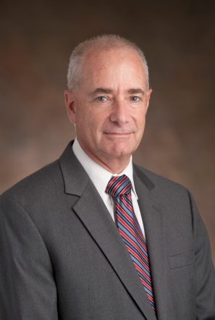
Chain of Command
John B. Chessare, MD, MPH
President and CEO
Nationally recognized healthcare leader
http://ahealthydialogue.blogspot.com

Slide 68
Chain of Command –
Reporting Concerns
When you have a concern, please approach your immediate supervisor or Volunteer Services
Use the Chain of Command tool on the INFOWEB
Skipping the chain of command may lead to longer resolution times

Slide 69

Checkpoint…
Time to switch to specifics from the Patient Experience perspective!

Slide 70
Consider the Patient
Take a moment. What fears might be on person’s mind when at the hospital?
The following is a list of fears from a patient study from the Beryl Institute*
*https://cdn.ymaws.com/www.theberylinstitute.org/resource/resmgr/Conference_2012/Beryl_Keynote_Presentation_f.pdf?hhSearchTerms=

Slide 71
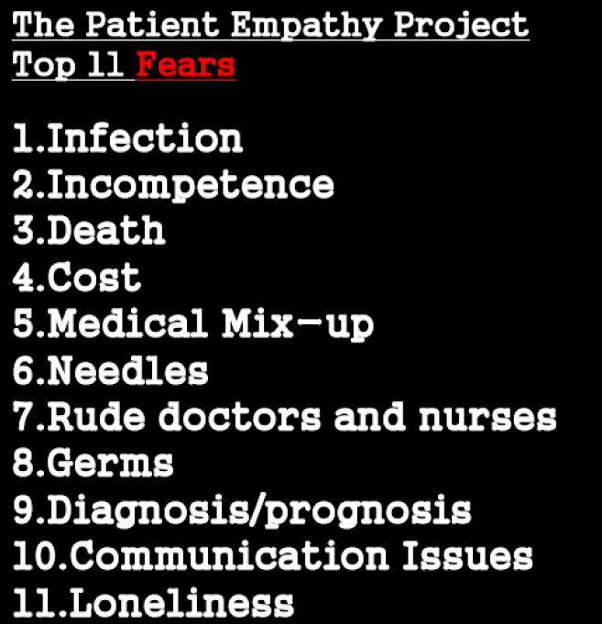

Slide 72

The GBMC Building Blocks
  Mission, Vision and Greater Behaviors
  Legal Requirements
    Patient Rights
    Notice of Privacy Practices
    Financial Assistance
  HCAHPS
  Diversity & Inclusion Policy
  Service Recovery – chain of command
  All in This Together
  These are what distinguishes GBMC from other institutions!

Slide 73
Mission
The Mission of GBMC is to provide medical care and service of the highest quality to each patient and to educate the next generation of clinicians, leading to
health, healing and hope
for the community.
Because GBMC is a teaching hospital, the reference to education was added to the mission statement in 2020.

Slide 74

Vision
To every patient, every time, we will provide
the care that we would want for
our own loved ones.

Slide 75
Vision
The VISION is carried out through the 4 AIMS:
BETTER HEALTH: The best possible health outcome
BETTER CARE: The best possible satisfaction with the way the care is delivered
LEAST WASTE: The least waste (time, effort, money)
MORE JOY: The most joy for those providing the care

Slide 76
Vision
Every volunteer role is aligned to the aims.
BETTER HEALTH: Fundraising for patient centered initiatives and roles which impact the hospital community such as flower arranging and musicians
BETTER CARE: Roles with one on one interaction such as greeting visitors and rounding on patients
LEAST WASTE: Helping hands which share tasks within an office or unit
MORE JOY: Volunteers contribute to this just by being here!

Slide 77

Greater Behaviors - Values

Slide 78

Greater Behaviors - Commitment
Every GBMC person is asked to commit to the Greater Behaviors
The Commitment Form describes the Behavior and Expectation in detail.
Please review and complete the online form.

Slide 79

HCAHPS-
Hospital Consumer Assessment of Healthcare Providers and Systems
National standardized publicly reported survey results measuring how patients feel about their care
Patients are sent surveys on a random basis by a company called Press-Ganey
The following are categories included in the survey:
  Overall Hospital Rating
  Willingness to Recommend Hospital
  Communication with Nurses
  Communication with Doctors
  Responsiveness of Hospital Staff
  Pain Management
  Communication about Medicines
  Discharge Information
  Care Transition
  Cleanliness of Hospital Environment
  Quietness of Hospital Environment
It is available for the public to compare hospitals at
www.medicare.gov/hospitalcompare.

Slide 80

Diversity & Inclusion
96
‘The diversity and inclusion mission of GBMC Healthcare system is to create a more diverse workforce and foster an inclusive workplace to provide culturally competent care and service of the highest quality to every patient, every time, leading to better health, better care, with the least waste of time, and with more joy for those providing the care.’
GBMC is a non-denominational hospital.

Slide 81

Diversity & Inclusion
Treat everyone with respect, regardless of cultural dimension or background.
Please read Volunteer Services Handbook on Hospital Policies

Slide 82

All in This Together!
Here is a list of ‘little things’ we can do which have a major impact!
  Wayfinding
  Litter
  Wheelchair wrangling
  Spills
  Service Response Center

Slide 83

Wayfinding
All of us have lost our way on the GBMC Campus!
Offer to escort a visitor to their destination or to an Info Desk
Escorting is much less stressful than just giving directions
Address Hints:
  6701 – Hospital Building
  6569 – West Pavilion
  6535 – North Pavilion
  6565 – East Pavilion

Slide 84

Litter
Litter leaves such a poor first impression
Follow the President’s example: pick it up and dispose of it

Slide 85

Wheelchair Wrangling
Wheelchair Corals can be found:
  Main Lobby (room on the right upon entry)
  OB entrance (under the stairs)
  ED entrance (next to ED doors)
  At Bus Loop (near Walgreens)
  PPW 3rd floor entrance
  PPN main level entrance
  Did I forget any?
Please respectfully offer if you suspect a need.
Please return abandoned wheelchairs to the closest coral.

Slide 86
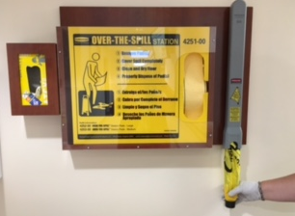
Spills
Help to prevent falls by keeping an eye out for spills!
Spill stations can be found around the hospital to help dry them up and highlight them for safety!

Slide 87
Service Response Center - 6800
One-stop-shop for all support service needs
Dial ext. 6800 to request any of the following
  Housekeeping/Environmental Services
  Patient Transportation
  Facilities and Maintenance
  Nutrition Services
Benefits of the SRC include:
  One centralized phone number for any support service need
  Software to track call volumes and issues
  Ability to make proactive improvements

Slide 88




One more thing…
Helpful Information in the Handbook
Please keep and refer to you Volunteer Handbook often
Benefits and Parking
    Please read Volunteer Services Handbook on Volunteer Policies

Slide 89

WAHOO! Almost DONE!
PLEASE
Complete and submit the Orientation Test
Complete the online Acknowledgement Form
Complete the online Greater Behaviors Form
See you at the in-person class!
  Invitation with details will be emailed to you once the tests and forms have been received
  Please continue to submit required health information

